Slide 1
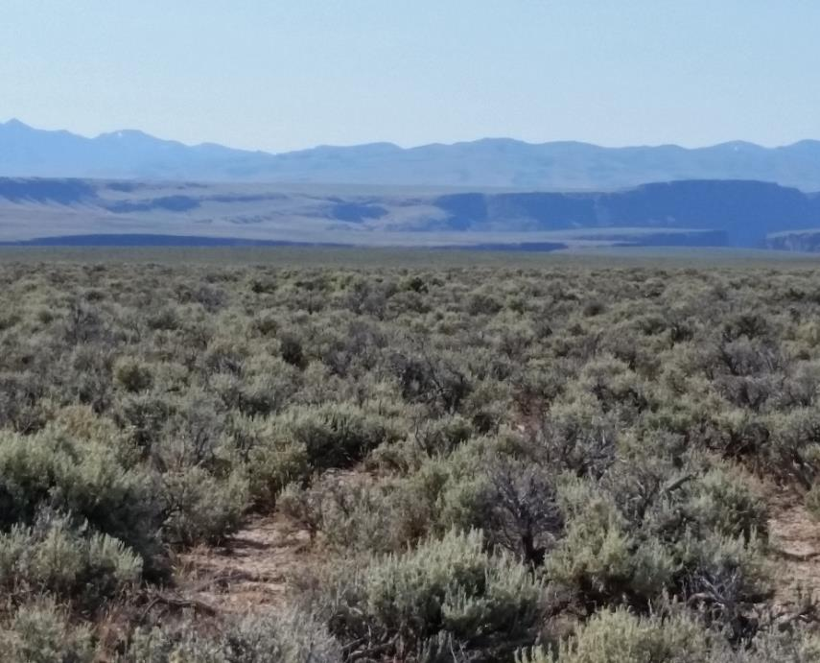
Rangelands of the Great Basin
University of Idaho Rangeland Program
K. Launchbaugh
Notes:
NOTE:
To change the image on this slide, select the picture and delete it. Then click the Pictures icon in the placeholder to insert your own image.

Slide 2
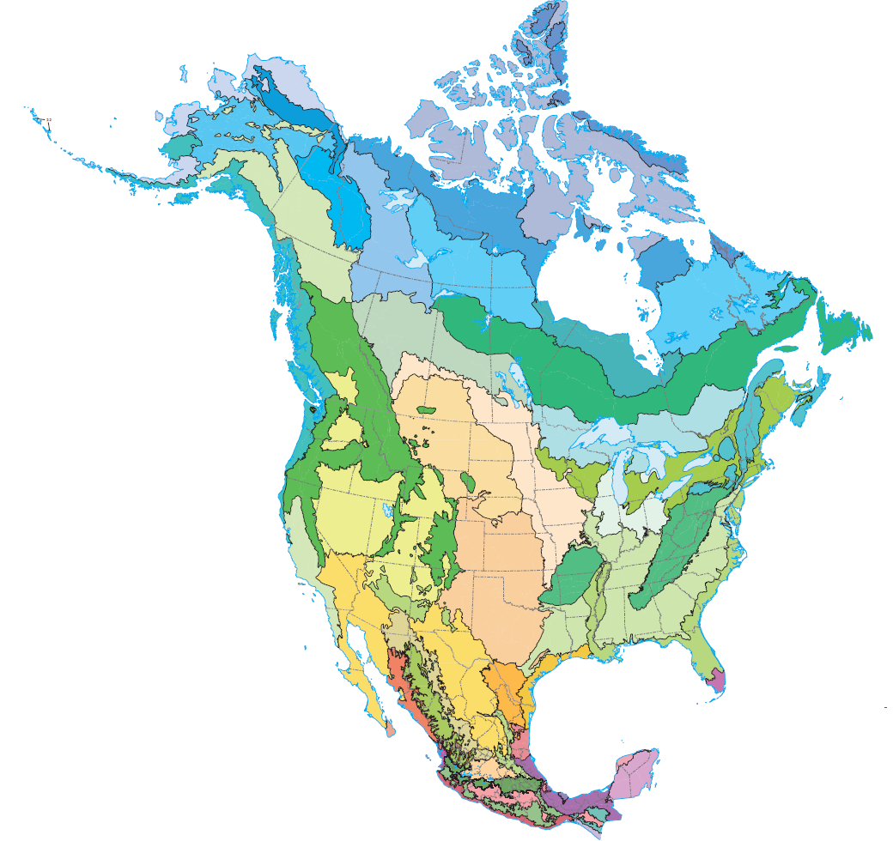

Ecoregions
Cold Desert Ecoregions
https://www.epa.gov/eco-research/ecoregions

Slide 3
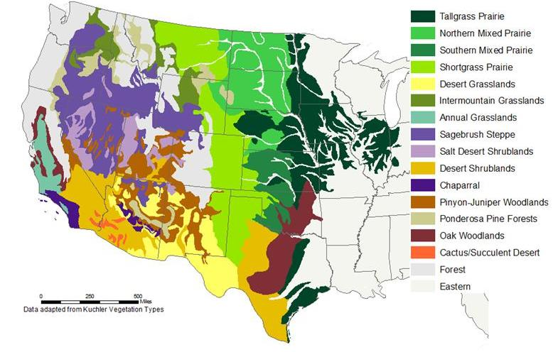

Slide 4
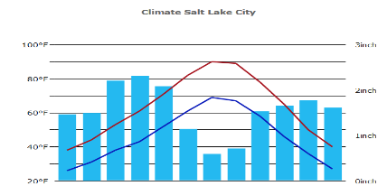
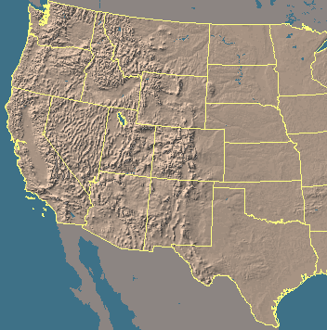
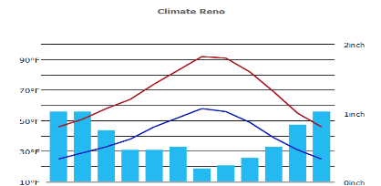
Great Basin
Salt Lake City, UT Average annual precip. =18.6"
3”
Pacific Northwest
Great
Basin
Rocky Mountains
Great Plains
Mediterranean
Reno, NV Average annual precip. =7.5"
2”
Southwest Deserts

Slide 5
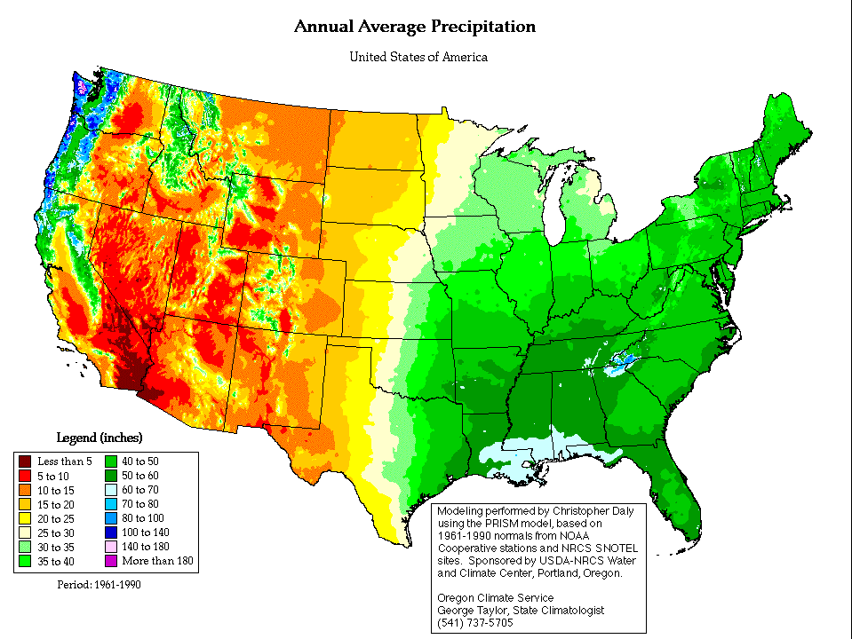
Variation in Annual Precipitation Across U.S.
Notes:
The Western U.S. has a lot of area that gets between 5 and 15 inches of rainfall.

Slide 6
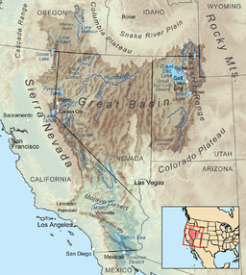
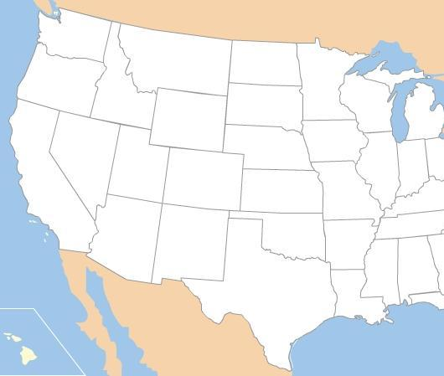
Great Basin Region
Great Basin
Notes:
Generalized map of rangeland vegetation types of the United States. Based mostly on A. S. Kuchler 1964. Potential natural vegetation of the conterminous Unites States. American Geographical Soc. Publ. #36.

Slide 7
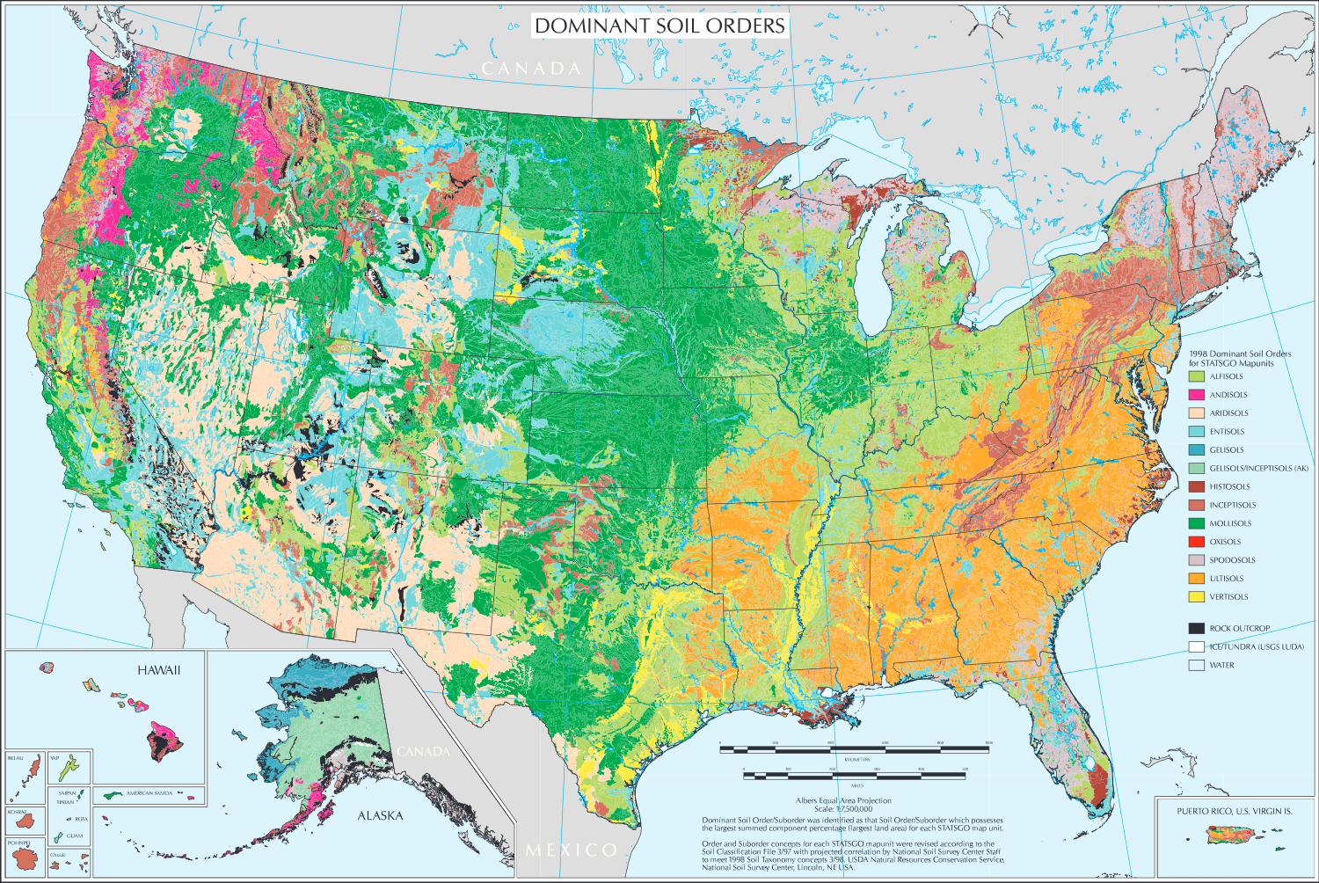
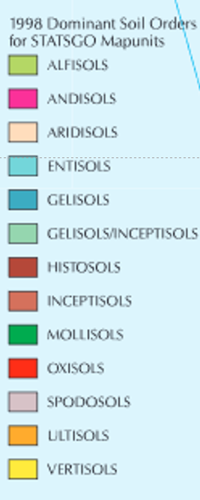
Dominant Soil Orders
Major Rangeland Soils
Notes:
There are essentially 3 soil orders that we will focus on because they are the primary soils in rangeland ecosystems

Slide 8
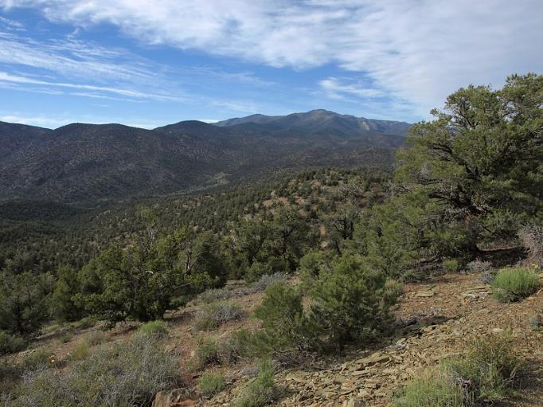
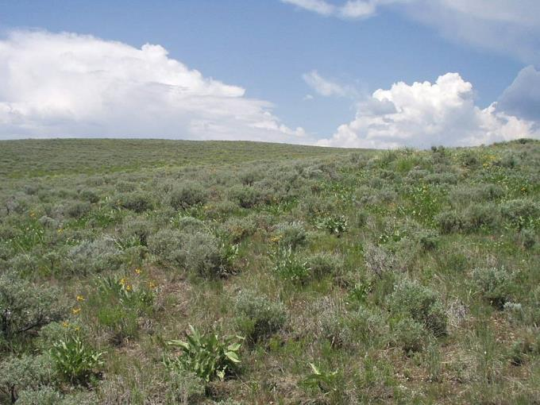
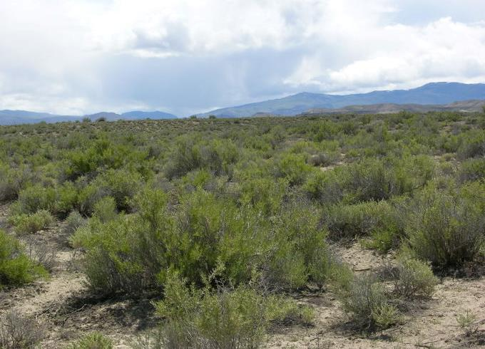
Higher Elevation
Pinyon-Juniper Woodlands
Mid-Elevation
Sagebrush Steppe
Low Elevation
Salt Desert Shrublands
Jim Morefield/Flickr
J. Peterson
J. Hankins
J. Peterson

Slide 9
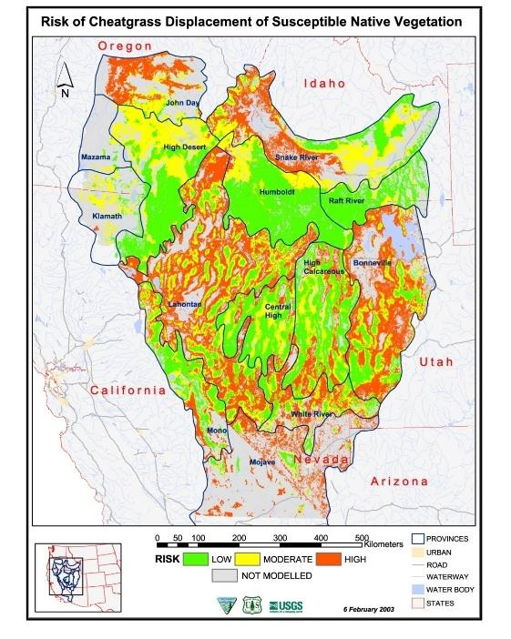
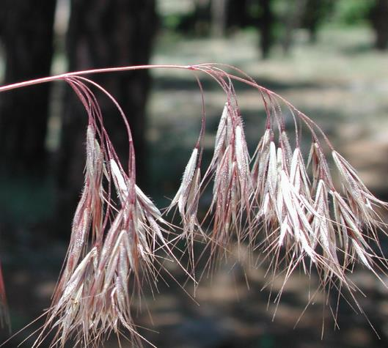
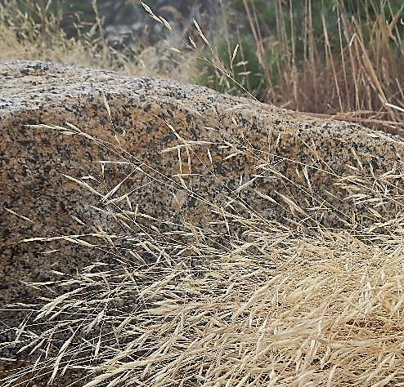
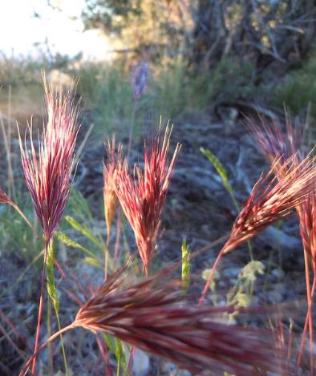
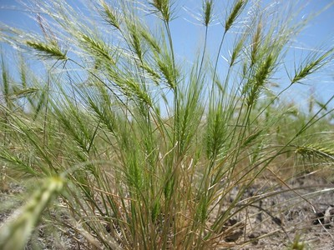
Annual Exotic Grasses
Cheatgrass
Ventenata
Mac Licher
Matt Lavin
Medusahead
Red Brome
Mat Lavin
Oregon State University

Slide 10
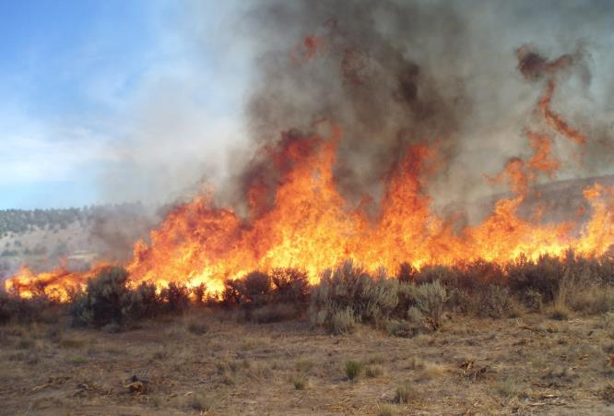
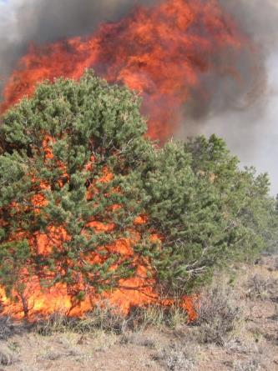
Increase Fire Frequency and Size of Fires

Slide 11
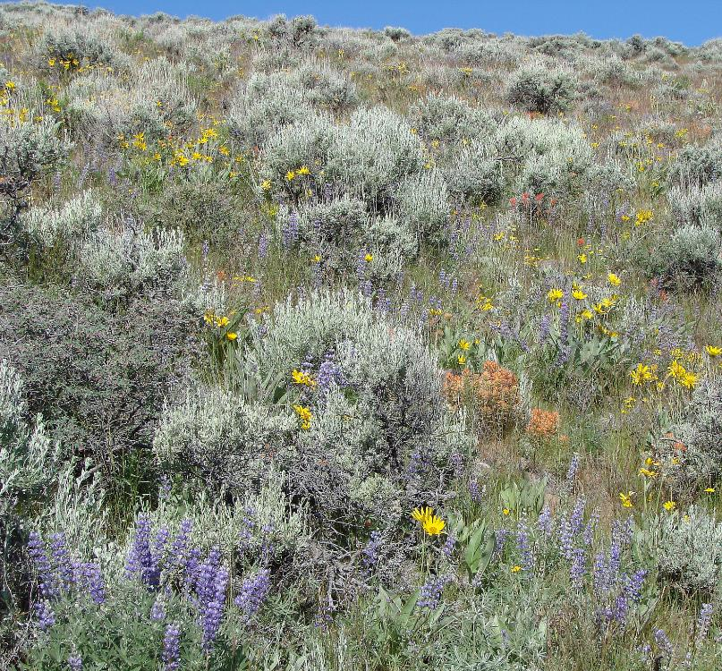
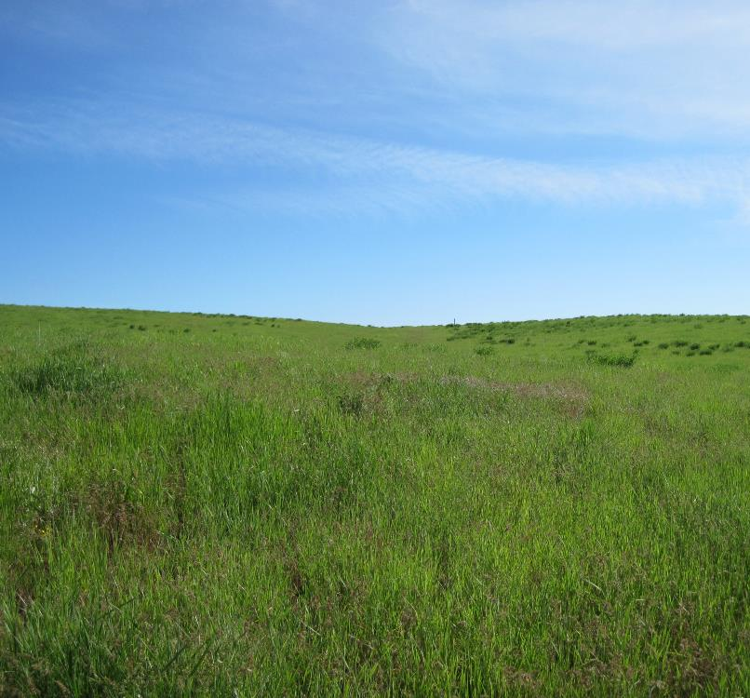
Fire Converts Shrub-Steppe to Grasslands
Tony Svejcar
K. Launchbaugh

Slide 12
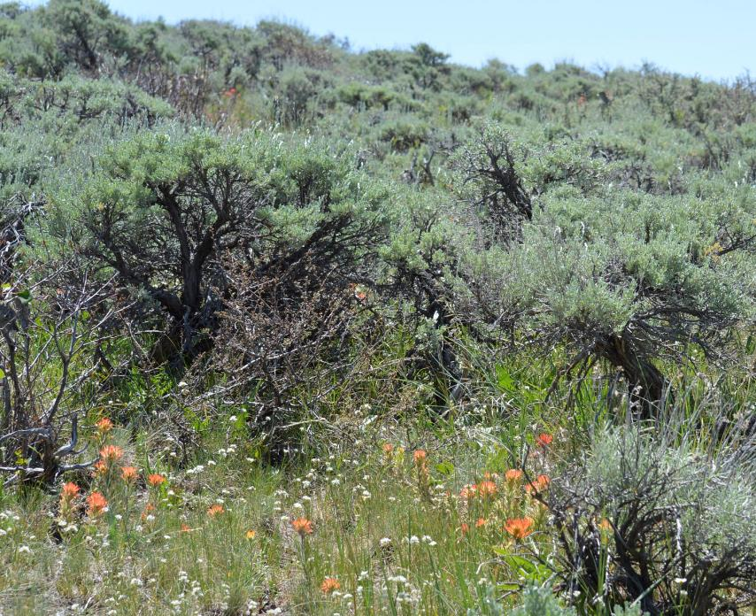
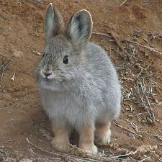
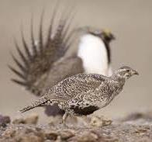
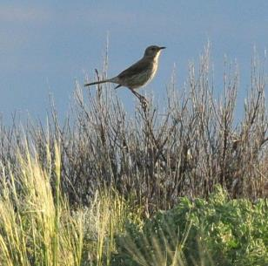
Sagebrush-Steppe – Big sagebrush
Important for livestock and wildlife
Food for native grazers/browsers
Supports nearly 100 bird species
Several sagebrush dependent species: pronghorn, pygmy rabbit, sagebrush vole, sage sparrow, Brewer’s sparrow, and sage thrasher
USFWS Mountain-Prairie
IDFG.Idaho.gov
IDFG.Idaho.gov
USFWS Mountain-Prairie
Pygmy Rabbit Sage-Grouse Sage Thrasher

Slide 13
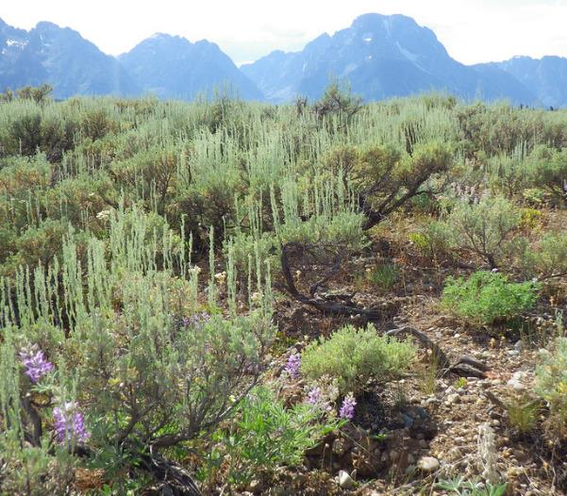
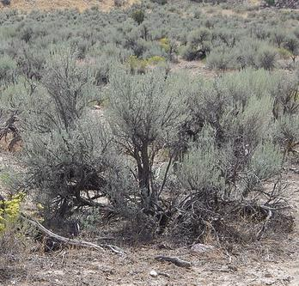
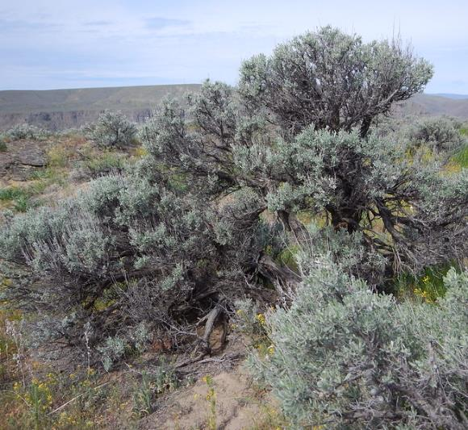
Big Sagebrush – 3 subspecies
Mountain big sagebrush
≥ 14 in.
Wyoming big sagebrush
8 – 12 in.
Basin big sagebrush
8 – 16 in.
Matt Lavin
Matt Lavin
Matt Lavin
Artemisia tridentata ssp. vaseyana
Artemisia tridentata ssp. wyomingensis
Artemisia tridentata ssp. tridentata
Notes:
Mountain – typically found at higher elevations, on meadows and slopes in mountains, precip at least 14 in.
Basin –lowest elevations to mid elevations, deep soils
Wyoming – overlaps in range and elevation with Basin, but typically on drier sites

Slide 14
Rangelands of the Great Basin
University of Idaho Rangeland Program
K. Launchbaugh
Notes:
NOTE:
To change the image on this slide, select the picture and delete it. Then click the Pictures icon in the placeholder to insert your own image.

