Slide 1

Leaf Characteristics
What you need to know to identify plants
Wildland Plant Identification
REM 252

Slide 2

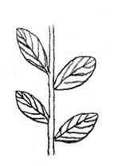
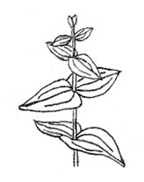
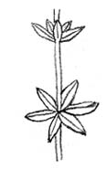
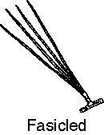
Leaf & Stem Arrangement
Basal
Alternate
Opposite
Whorled
Fascicled
basal
Alternate
Opposite
Whorled

Slide 3
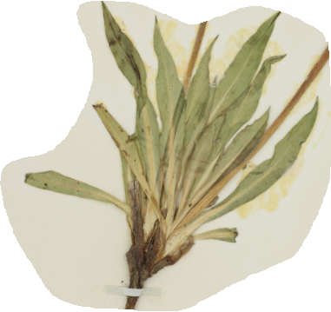
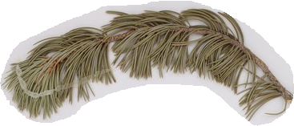
Leaf & Stem Arrangement
Basal
Opposite
Alternate
Whorled
Fascicled
Basal Arrangement:
Agoseris glauca
Fascicled:
Pinus edulis

Slide 4
Leaf Arrangements
Alternate
Opposite
Whorled

Slide 5
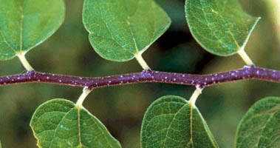
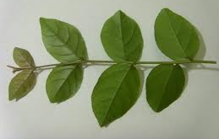
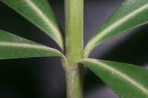
Leaf Arrangement
Opposite
Alternate
Whorled

Slide 6
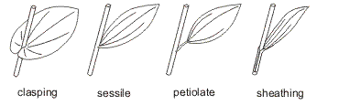
Leaf Attachment
Clasping
Sessile
Petiolate
Sheathing
Notes:
Sessile = fixed in one place (think of a barnacle)
Clasping = version of sessile where the base of the blade goes almost entirely around the other side of the stem
Sheathing = blade forms cylinder/tube around the stem

Slide 7
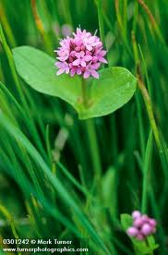
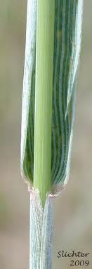
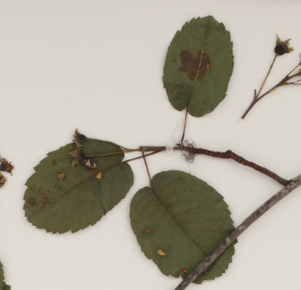
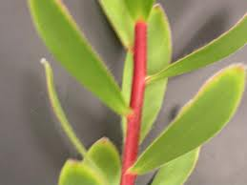
Petiolate
Sheathing
Clasping
Sessile

Slide 8
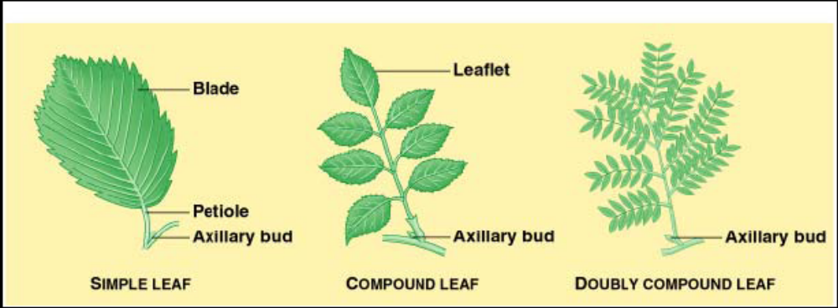
Leaf Type: Simple or Compound

Slide 9
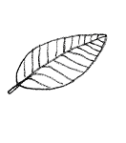
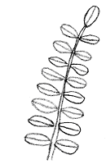
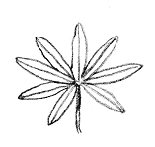
Leaf Types
Simple
Compound
Palmately Compound
Pinnately Compound
Notes:
Think: oak (simple), lupine (palmate compound), mimosa (pinnate compound)

Slide 10
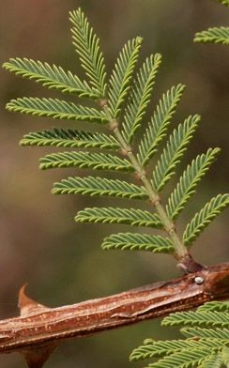
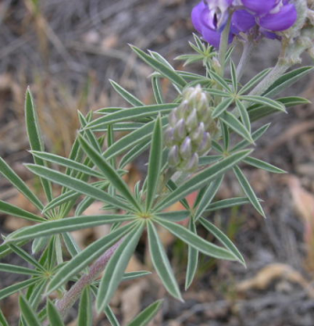
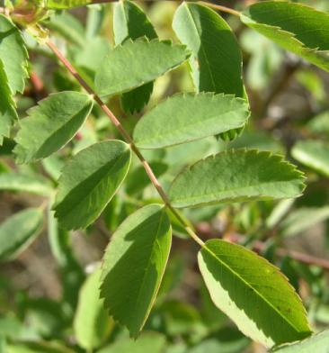
Compound Leaves
Palmate
Pinnate

Slide 11
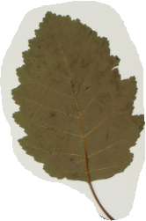
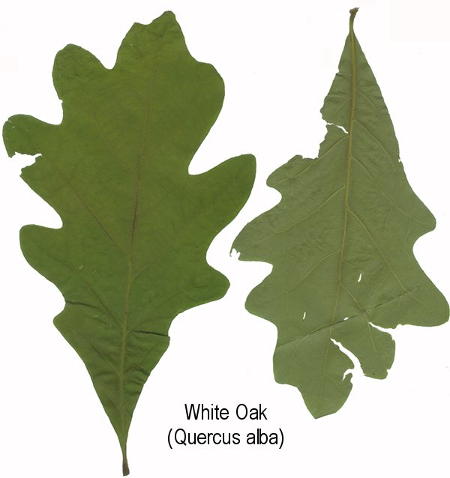
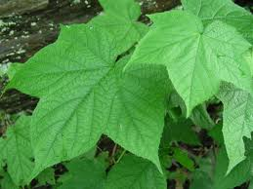
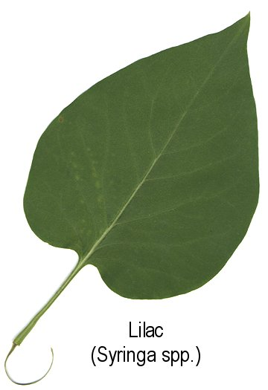
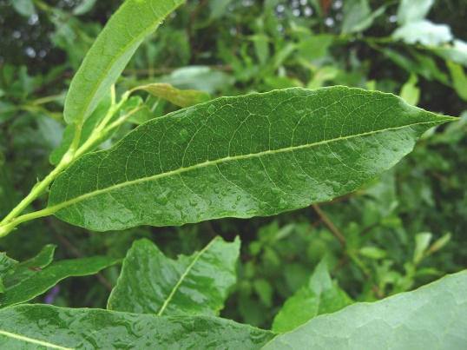
Simple Leaves
uptreeid.com
uptreeid.com
gobotany.com

Slide 12





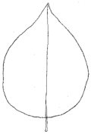
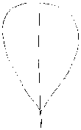
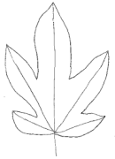

Leaf Shapes
Linear
Elliptic
Lanceolate
Oblanceolate
Ovate
Obovate
Palmate
Wedge-shaped
Arrow-shaped

Slide 13

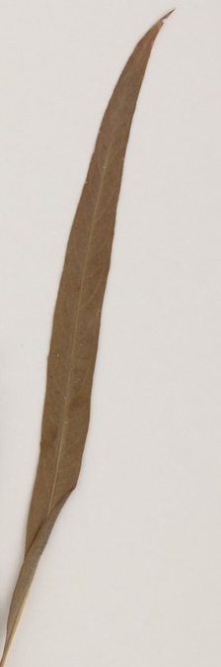
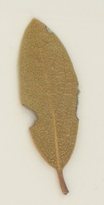
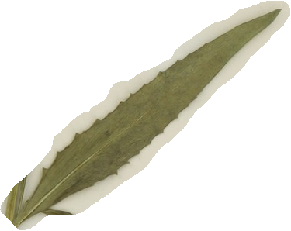
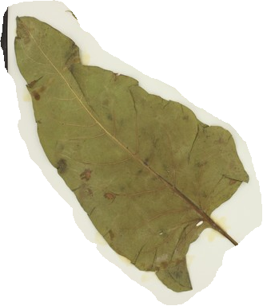



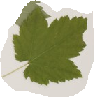
Leaf Shapes
Elliptic
Arctostaphylos pungens
Lanceolate
Senecio serra
Oblanceolate
Hymenoxys hoopesii
Linear
Salix exigua
Obovate
Arctostaphylos
Uva-ursi
Ovate
Populus tremuloides
Palmate
Acer glabrum
Wedge-shaped
Artemisia tridentata
Arrow-shaped
Balsamorhiza sagittata

Slide 14
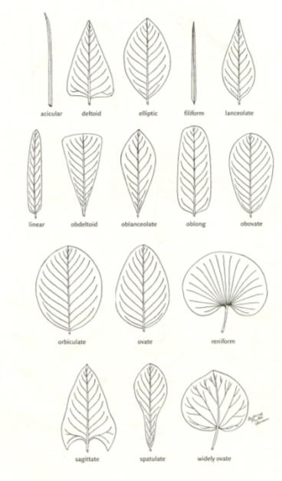
Leaf Shapes
Fig. 11

Slide 15


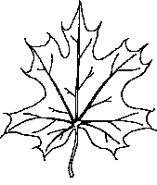

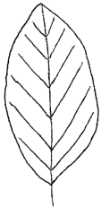
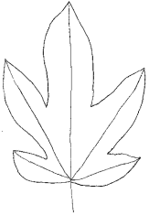
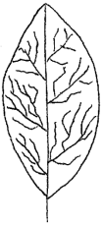
Leaf Venations
Parallel
Pinnate
Palmate
Netted

Slide 16

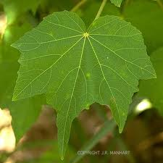
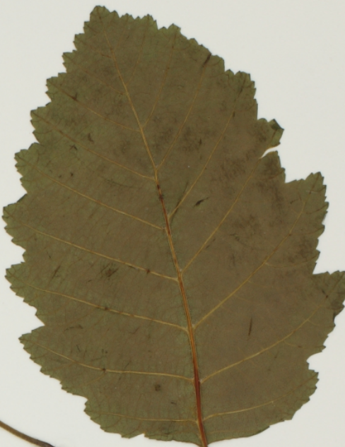
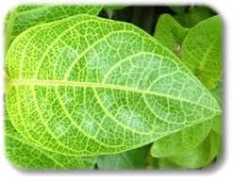
Palmate Venation
Pinnate Venation
Parallel Venation
Netted Venation

Slide 17



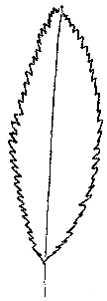
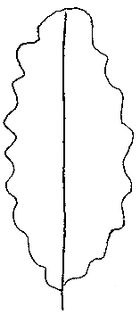
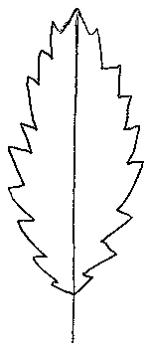
Leaf Margins
Pinnately Lobed
Palmately Lobed
Entire
Serrated
Scalloped
Toothed

Slide 18
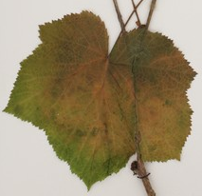
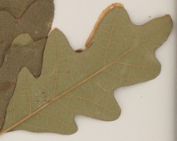
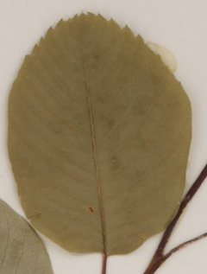
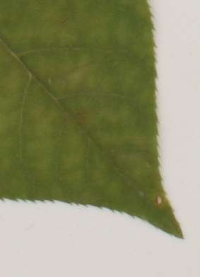
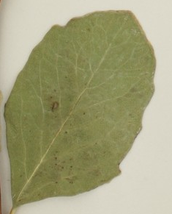

Leaf Margins
Pinnately Lobed
Quercus gambelii
Palmately Lobed
Rubus parviflorus
Entire
Symphoricarpos albus
Serrated
Prunus virginiana
Scalloped
Symphoricarpos occidentalis
Toothed
Amelanchier alnifolia

Slide 19

More Leaf Margins
www.infovisual.info/01/011_en.html
If a leaf margin is very ragged and like it has been cut and sliced… then the margin would be called incised or divided. It could be palmately divided, pinnately divided or highly divided:

Slide 20

More Leaf Margins
If a leaf margin is very ragged and like it has been cut and sliced… then the margin would be called incised or divided.
It could be palmately divided, pinnately divided or simply “highly divided”

Slide 21




Examples of Incised or Divided Leaf Margins
lucidcentral.org
greergardens.com
Palmately Divided
Maple (Acer sp.)
pnwherbaria.org
Incised
Common dandelion
(Taraxacum officinale)
Highly Divided
Queen Anne’s lace (Daucus carota)
botany.0catch.com
Pinnately Divided
Black mustard (Brassica nigra)

Slide 22

Leaf Margins
Fig. 13 in Book

Slide 23
Websites
http://www.pnwherbaria.org/
http://plants.usda.gov/java/
http://biology.burke.washington.edu/herbarium/imagecollection.php
http://idahograssbook.wix.com/close-up

