Slide 1
Plant Classification & Naming
Wildland Plant Identification

Slide 2
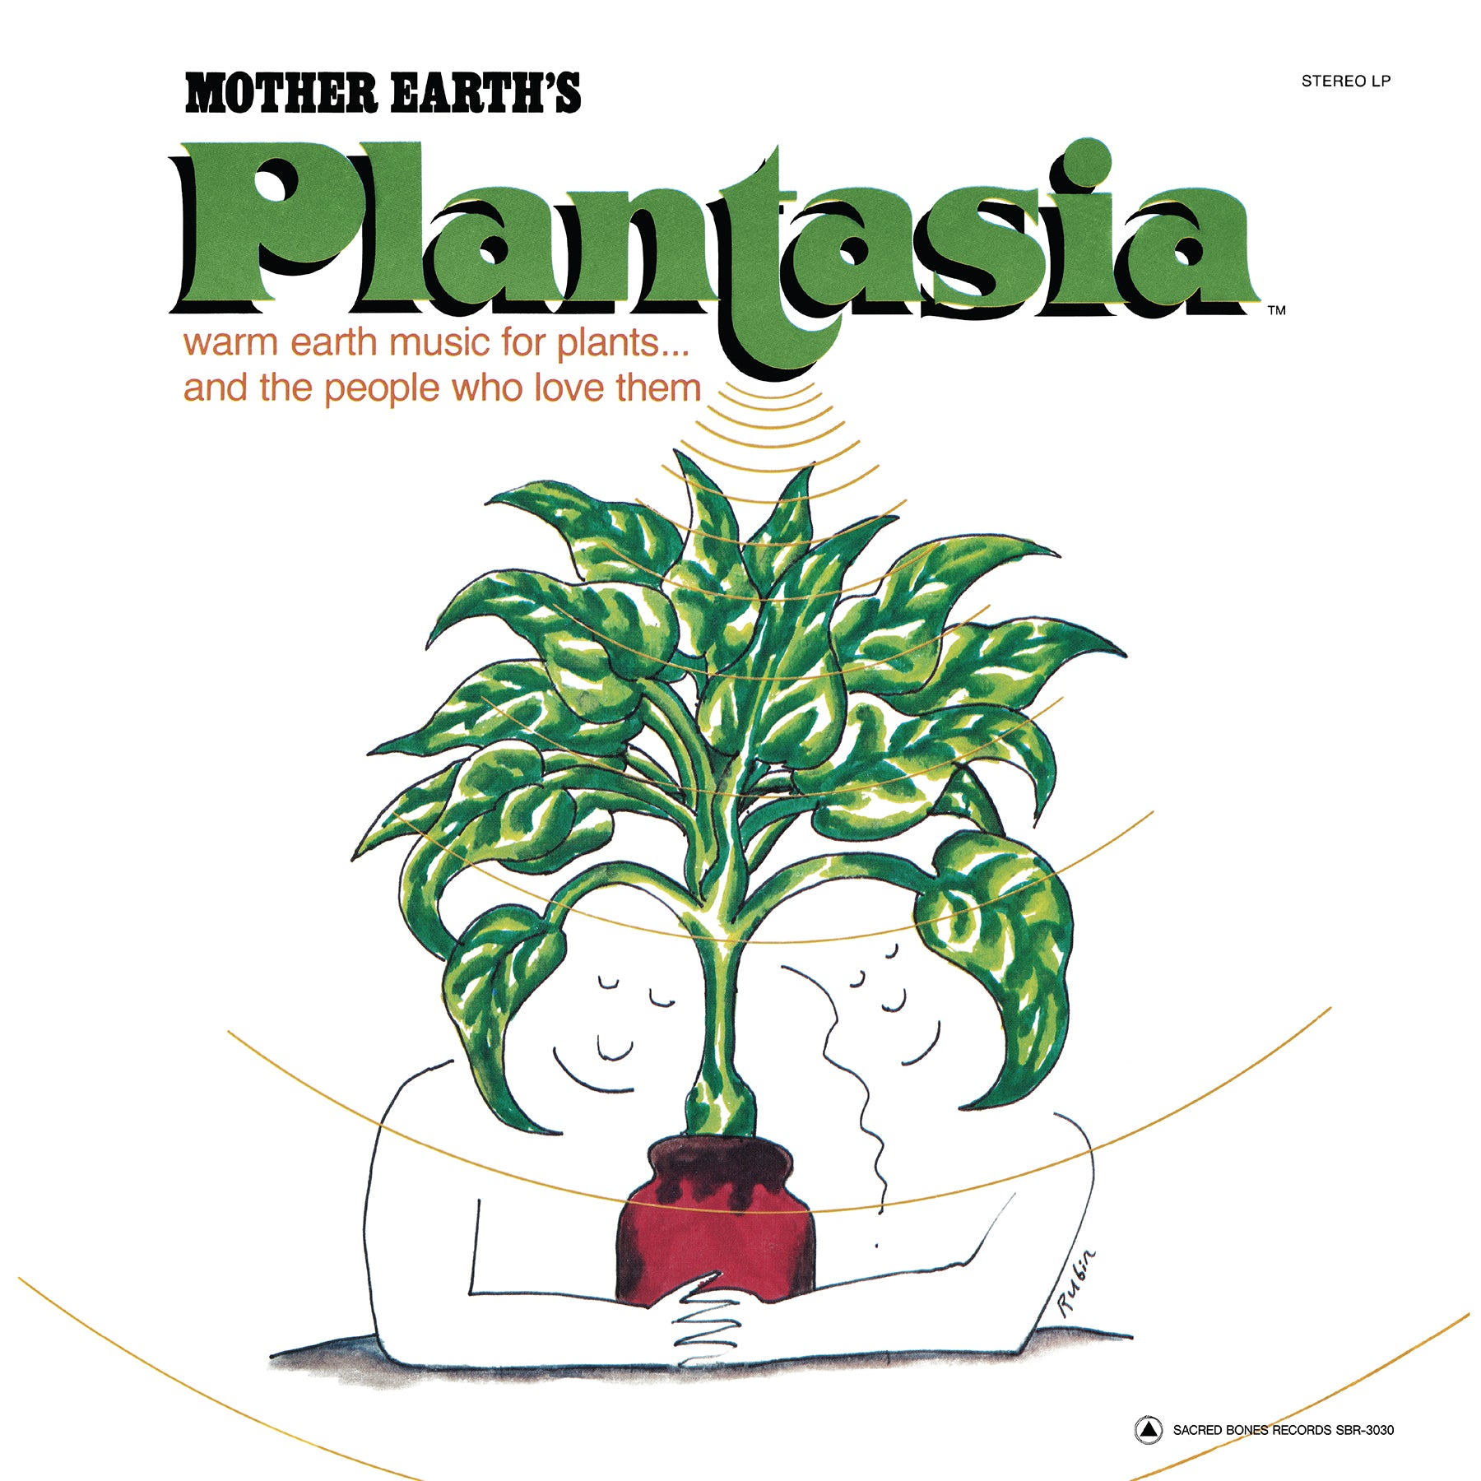
Mort Garson, Plantasia, 1976
https://www.youtube.com/watch?v=LkesIsPGlSU
One of the first electronic albums
Music for plants to listen to
MG also composed soundtrack to live televised moon landing

Slide 3
Taxonomic Classification
kingdom (plants)
division (phylum)
class
order
family
tribe
genus
specific epithet

Slide 4
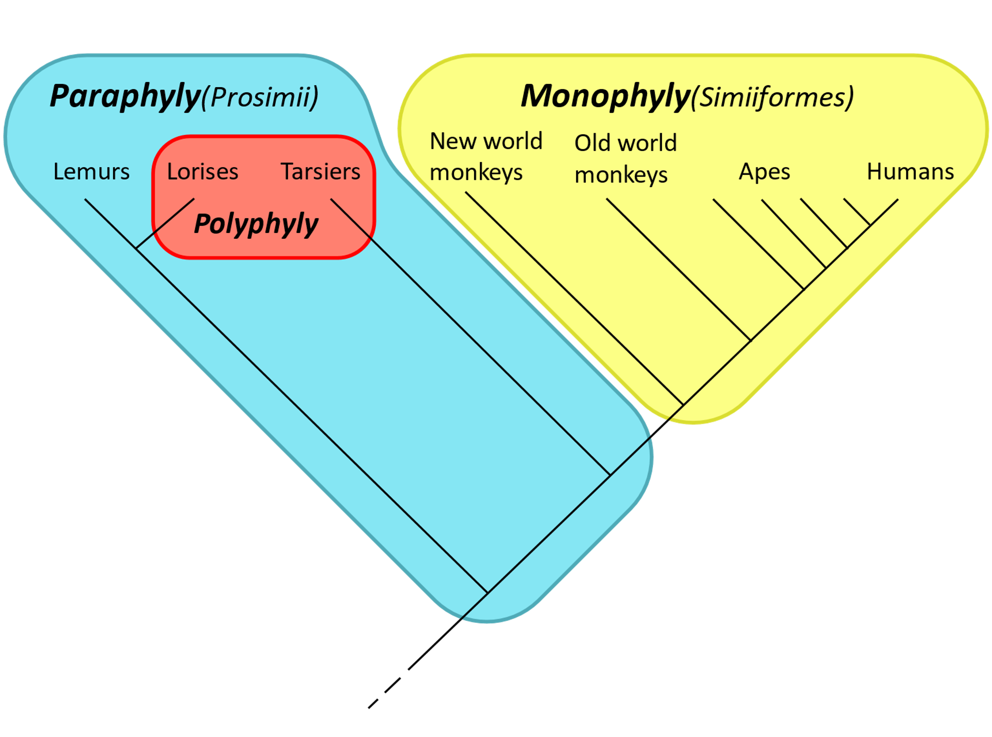
How Taxonomy Works
Things are grouped by common ancestor
Ideally into monophyletic clades

Slide 5
Taxonomic Kingdoms
Eubacteria
Protista
Fungi
Archae-bacteria
Animalia
Plantae
Notes:
Domain: eukaryotes vs prokaryotes
Eukaryotes have organelles (ribosomes make protein, rhizomes propagate plants)

Slide 6
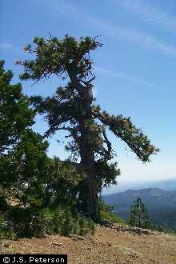
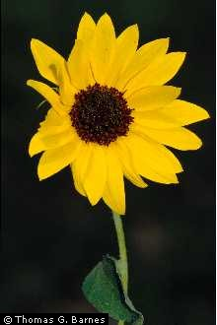
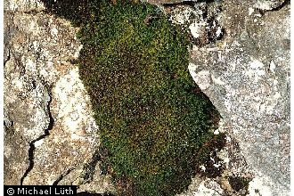
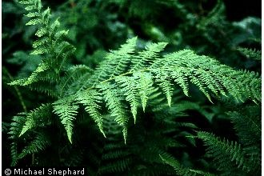
Phyla in Plantae
Plantae
Bryophyta
Pteridophyta
Coniferophyta
Magnoliophyta
Notes:
Bryophytes: mosses; non vascular. Reproduce via spores or via fragmentation (asexual)
Pteridophytes: ferns and lycophytes; reproduce via spores; possibly a polyphyletic clade bc ferns more closely related to seed-bearing plants than lycophytes
Lycophytes = one of the oldest lineages of vascular plants, eg clubmosses. One of the dominant groups during carboniferous period, w some plants 40 meters tall
Coniferophytes = conifers. Produce cones. Only one extant class; ~600 species (pretty small for a phylum)
Magnoliophyta = flowering plants

Slide 7
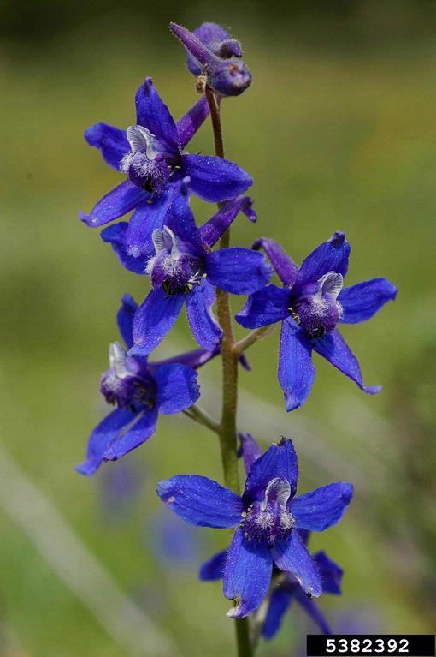
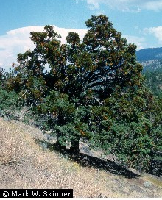
Plant Class/Order
Kingdom
Phylum
Class
Order
Family
Plantae
Magnoliophyta
Magnoliopsida
Ranunculales
Ranunculaceae
Plantae
Coniferophyta
Pinopsida
Pinales
Cupressaceae
Notes:
Compare: larkspur and cyprus diverge from each other very early

Slide 8
Botanical Nomenclature
Plants are described and grouped based mostly on their flowering structure or other reproductive parts.
kingdom (plant)
division (phylum)
class
order
family
tribe
genus
specific epithet
General
Specific

Slide 9
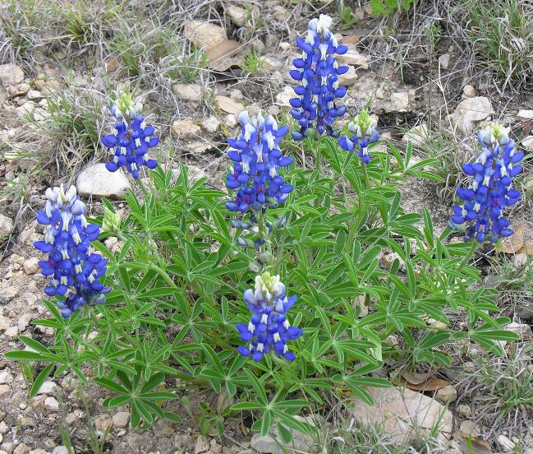
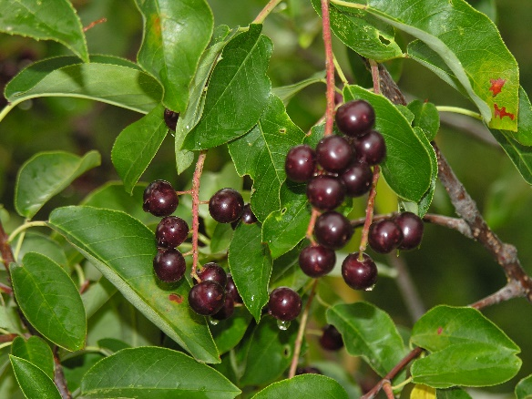
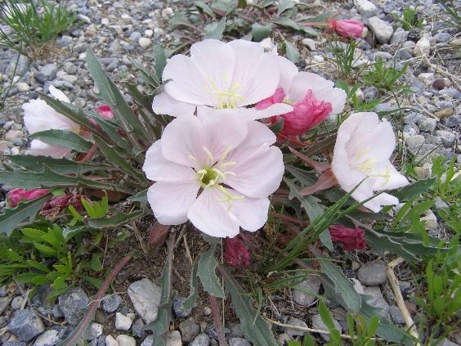
Plant Family
Plants with similar flower/fruit structure
  Number of sepals and petals
  Type and number of stamens and pistils
  Similar fruits
  Name ends in “aceae”
  For example, Fabaceae, Chenodiaceae, Asteraceae, Rosaceae, etc.

Slide 10
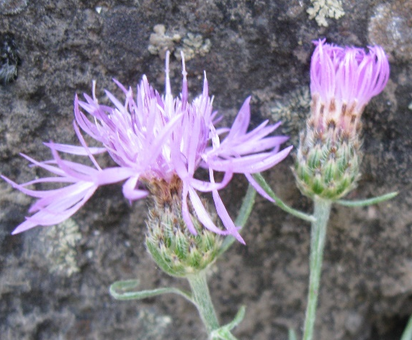
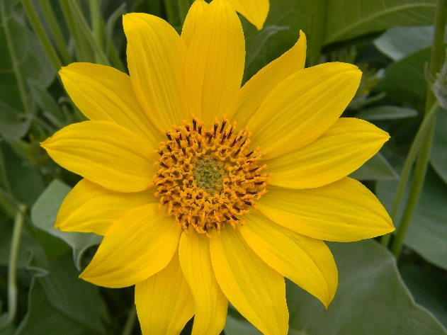
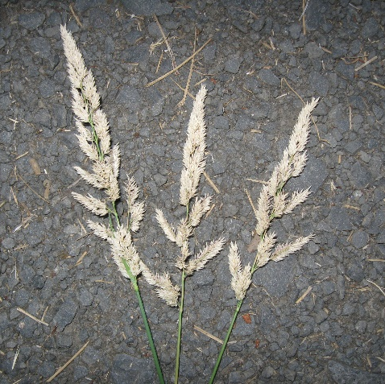
Tribes
Large families are further separated into Tribes
  In this class, will recognize tribes in the Poaceae & Asteraceae
  Tribe names end in “eae” without an “ac” before the “eae”
  Astereae, Heliantheae, Poeae, Aveneae, etc.

Slide 11
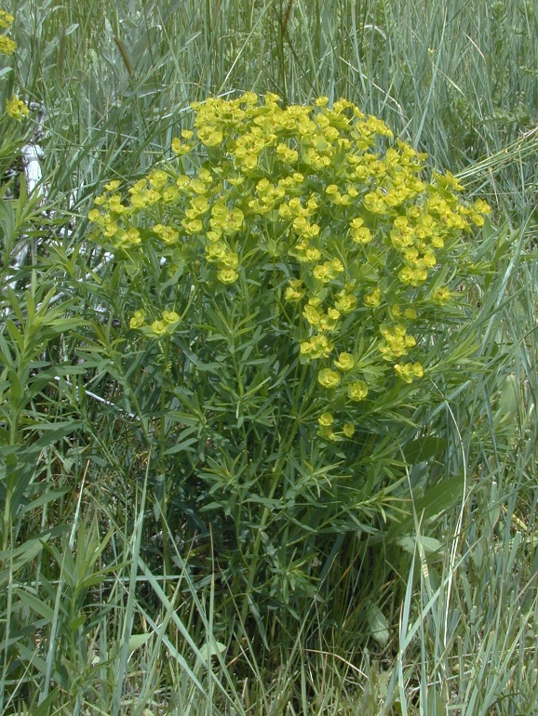
Genus
Based on similarities in flowers/fruits
Also, similar morphological or other plant characteristics
Genus is capitalized and is italicized or underlined when typed in a document
Leafy Spurge
Euphorbia esula
In the Euphorbiaceae family

Slide 12
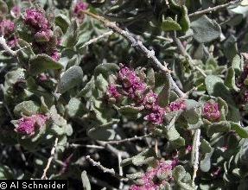
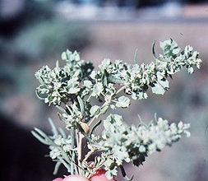
Specific epithet
Second part of the scientific name
May be several species in a genus – distinguished by different specific epithets
Not capitalized and is italicized or underlined when typed in a document
Shadescale Saltbrush
Atriplex confertifolia
Fourwing Saltebrush
Atriplex canescens
In the Chenopodiaceae family

Slide 13
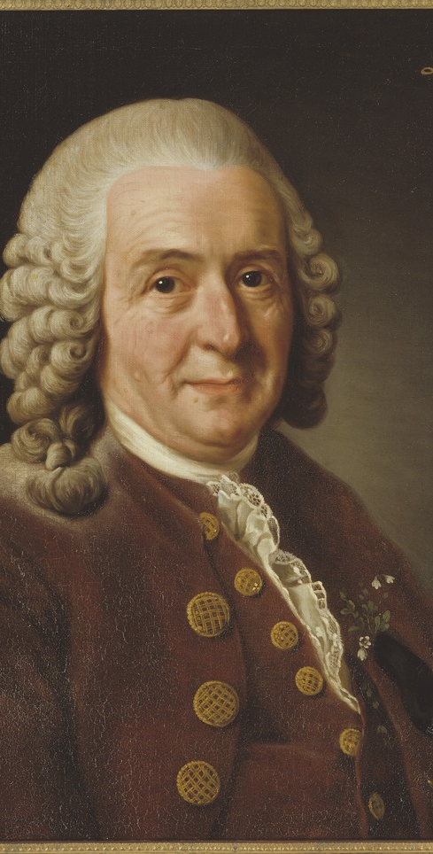
Authority
Initials at end of a scientific name are abbreviation of person who named plant:
  L. = Carolus Linnaeus (1707–1778), Swedish botanist and author of Species Plantarum, which is the starting point for botanical nomenclature
  Nutt. = Thomas Nuttall (1786–1859), English-American naturalist who collected in western United States
By Alexander Roslin - Nationalmuseum, Public Domain, https://commons.wikimedia.org/w/index.php?curid=52119229

Slide 14
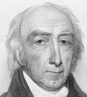
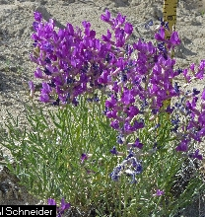
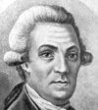
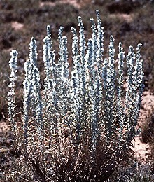
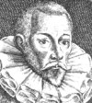
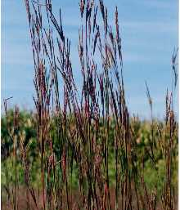
Plants named after people
People like to name plants after themselves or someone else
  Usually specific epithet, not the genus
  Often end in -i or -ii,
  Latin endings that mean “of” when added to “masculine” nouns
    geyeri, nelsonii, parryi, etc.
  But not Always
    muhlenbergia, danthonia, bouteloua, etc.
Aylmer Bourke Lambert
Oxytropis lambertii
Stepan Petrovich Krascheninnikov
Krascheninnikovia lanata
John Gerard
Andropogon gerardii

Slide 15
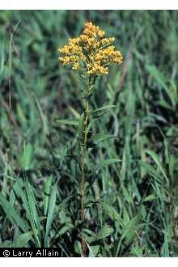
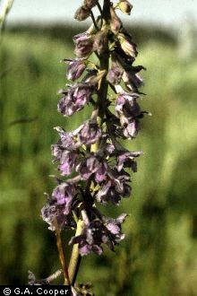
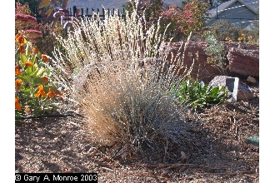
Plants named for places
Some plants names after places
  Almost always in the specific epithet, not the genus
  Often words ending in -nsis or -is
    idahoensis, missouriencis, nebrascensis, etc.
  But not always
    californica, virginiana, pratense, occidentale
Festuca idahoensis
Delphinium occidentale
Solidago missouriensis

Slide 16
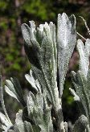
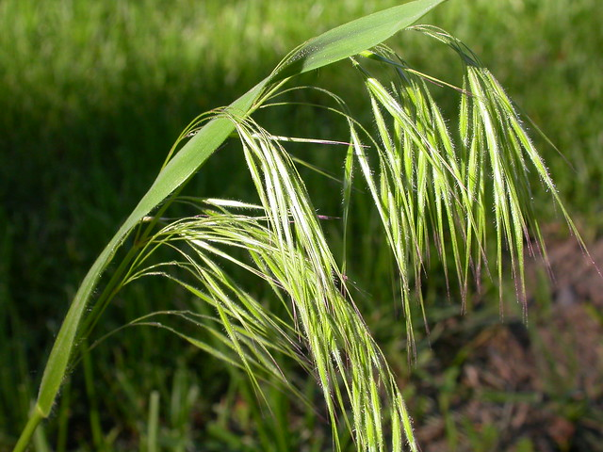
Plants names that describe
Many plant names describe characteristics
  Usually specific epithet, not the genus
  Describe leaf or stem
    tridentata, eriopoda, gracilis, nutans
  Or what plant was used for
    tectorum, hypericum, officinale
Artemisia tridentata
Bromus tectorum
Notes:
Tectorum = greek tector "overlaying" + tectum "roof" (often grew on thatched roofs)

Slide 17
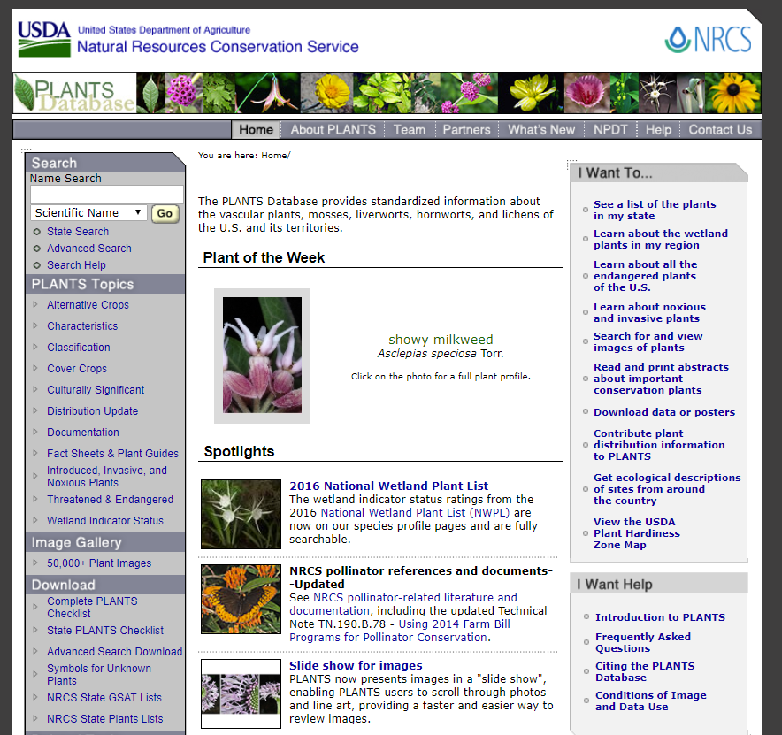
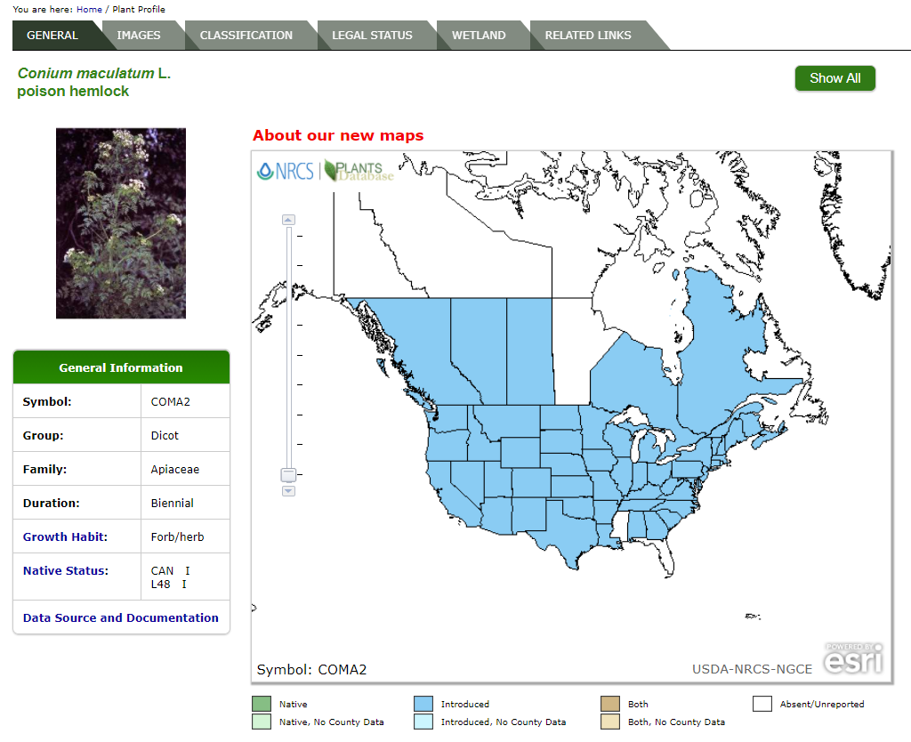
USDA PLANTS Database
https://plants.usda.gov
THE taxonomic source
for current plant names in the U.S.
  Species classification
  Taxonomy, authority
  Images, maps
  Standardized species
  codes
  Growth habit, native
  status, etc.

Slide 18

Meaning of Scientific Plant Names
Plant names reflect a Greek or Latinized term to highlight a characteristics of the plant or the person it was named for.
For example, leafy spurge
  Euphorbia esula L.
    Eu= "good" + “phorbe” = pasture or fodder
    “euphorbia” = good feed. Many members of this
    genus are good feed. In fact, leafy spurge is
    good forage for goats and sheep.
    esula = “sharp” referring to the acrid juice of this species
    L. = named by Linnaeus

Slide 19
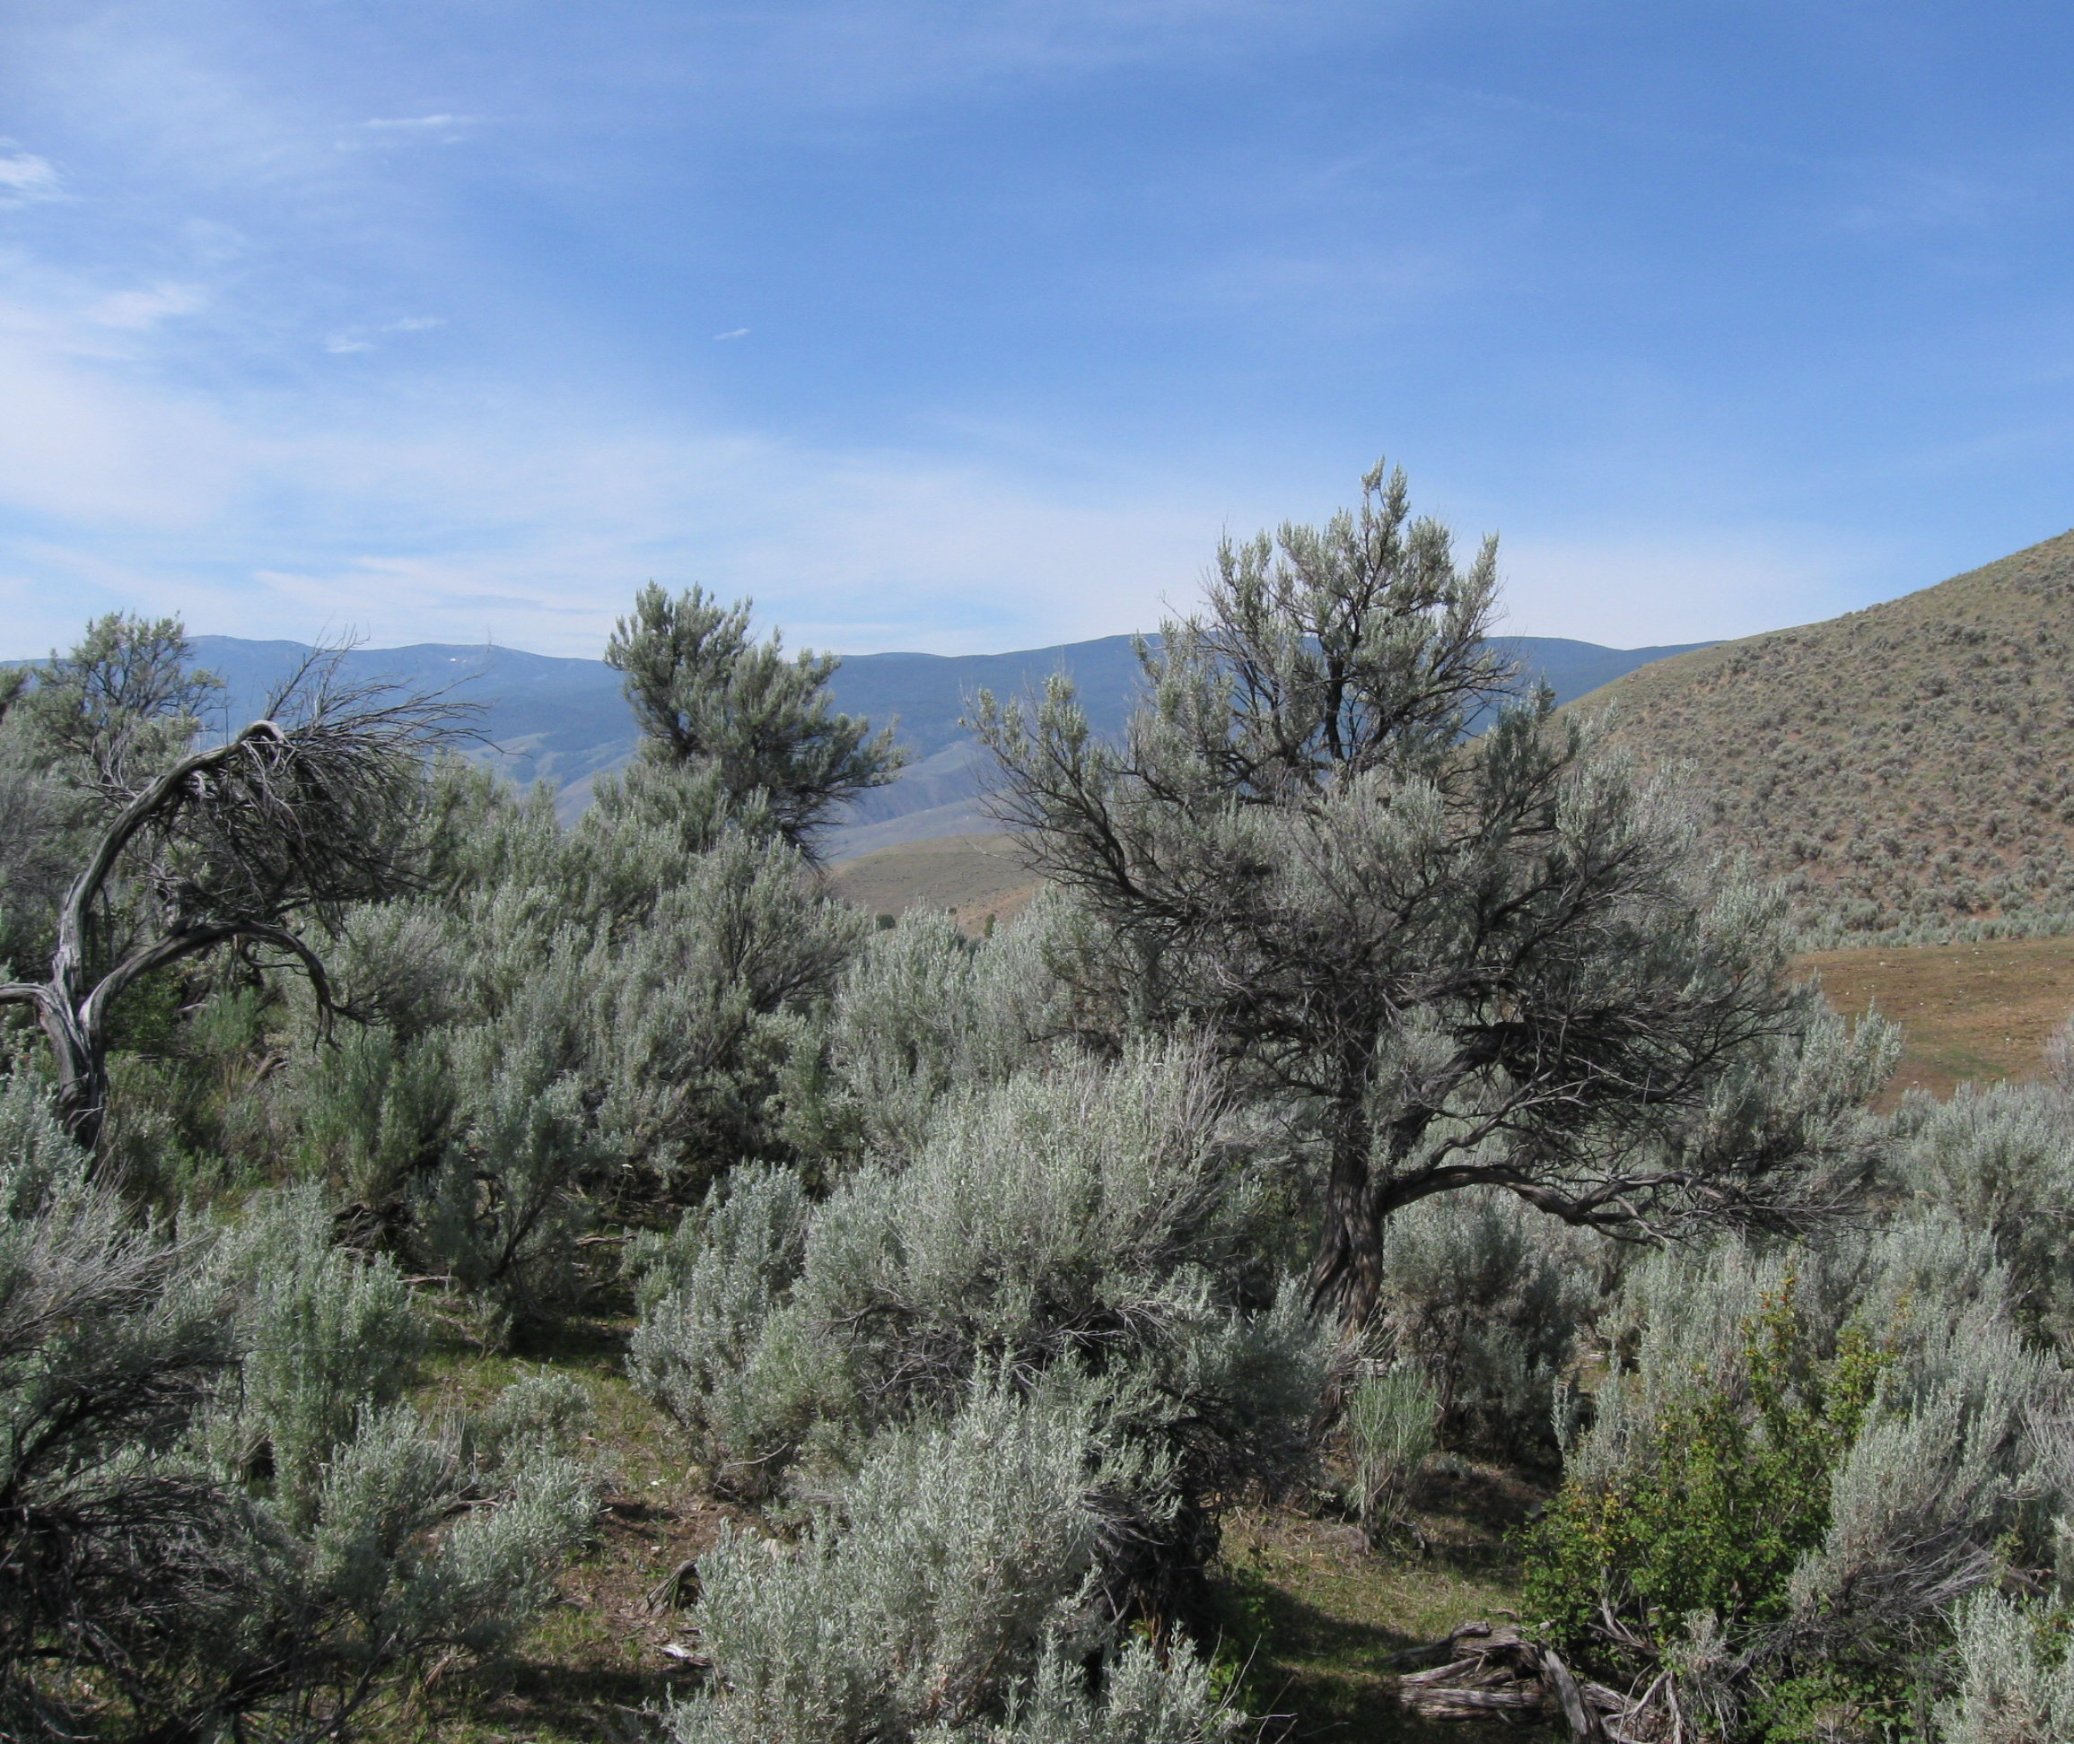
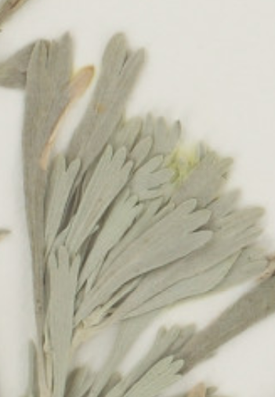
Meaning of Plant Names
Big Sagebrush
Artemisia tridentata
  Artemisia = Greek goddess of wild animals and plants
  tridentata = Three toothed (tri = 3 + dent = tooth)

Slide 20
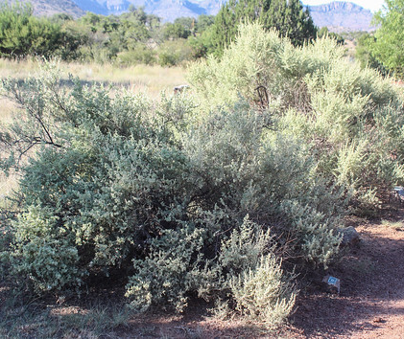
Meaning of Plant Names
Fourwing saltbrush
Atriplex canescens
  Atriplex = Old Latin name for this plant
  canescens = white or gray

Slide 21
Scientific Names
To remember a scientific name it helps to know what it means or who it was named for.
To figure out want plant names mean, visit these websites:
  http://www.calflora.net/botanicalnames/
  http://theseedsite.co.uk/latin.html

Slide 22
Plant Names
Poison Hemlock
Conium maculatum L.
Apiaceae (Carrot Family)
For this class, know
  Common Name
  Family or Tribe
  Be able to recognize the genus & specific epithet
Common Name
Family
Genus
Specific epithet
Authority

