Slide 1
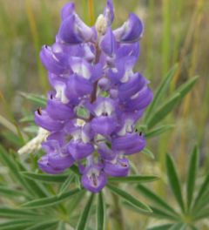
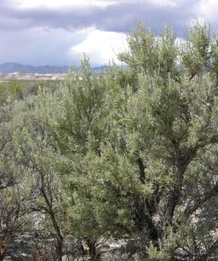
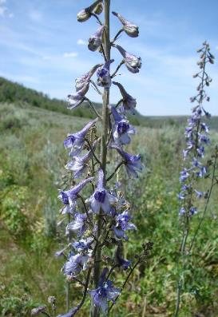
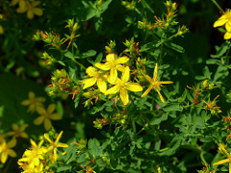

Toxic Rangeland Plants
J. Peterson
K. Launchbuagh
Sheri Hagwood - BLM
Rusty Clark

Slide 2
Toxic Rangeland Plants
Family/Tribe | Genus species | Name | Longevity | Origin
CHENOPODIACEAE | Halogeton glomeratus | Halogeton | Annual | Introduced
CLUSIACEAE | Hypericum perforatum | St. Johnswort | Perennial | Introduced
FABACEAE | Lupinus caudatus | Tailcup Lupine | Perennial | Native
RANUNCULACEAE | Delphinium bicolor | Low (or Little) Larkspur | Perennial | Native
RANUNCULACEAE | Delphinium occidentale | Tall Larkspur | Perennial | Native
FAGACEAE | Quercus gambelii | Gambel Oak | Perennial | Native
PINACEAE | Pinus ponderosa | Ponderosa Pine | Perennial | Native
SENECIONEAE | Tetradymia canescens | Gray Horsebrush | Perennial | Native

Slide 3
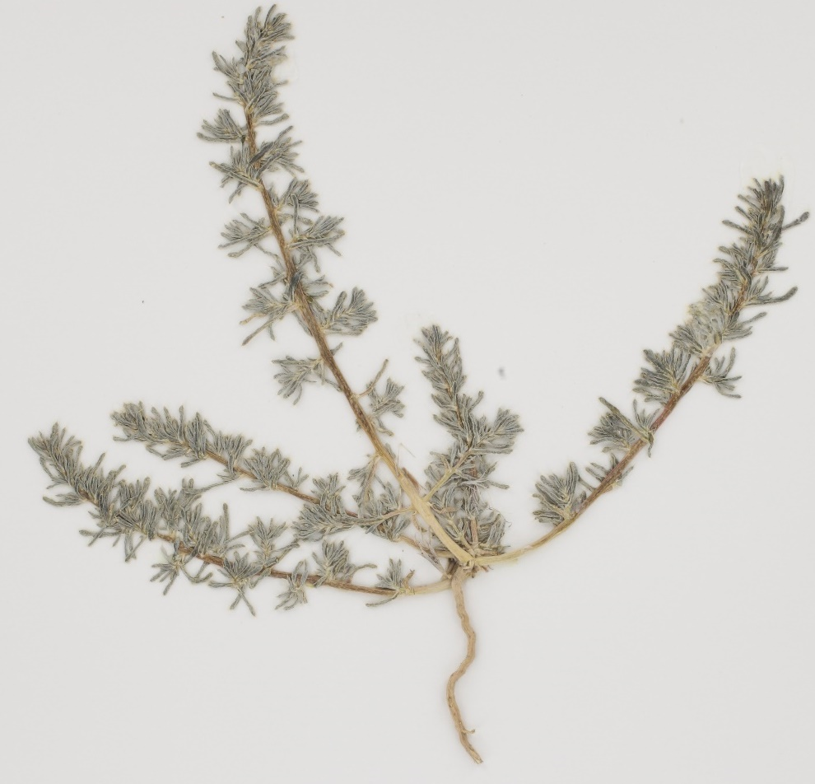
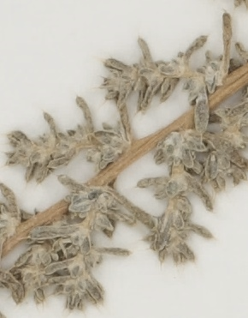

Slide 4
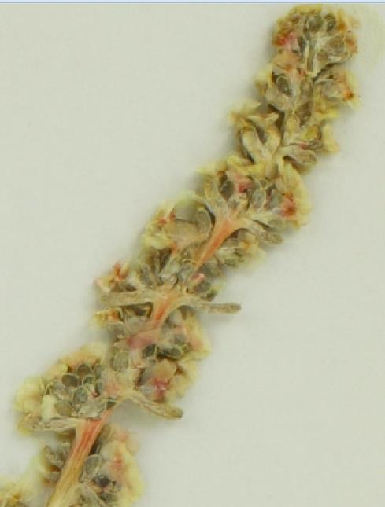
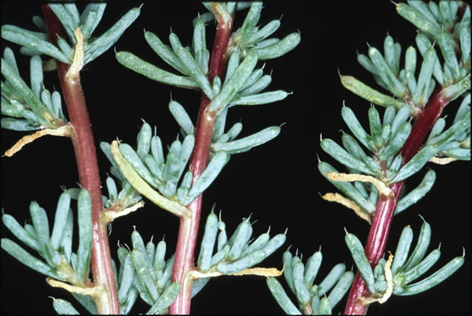
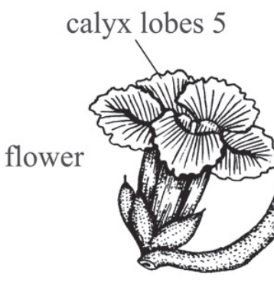
CHENOPODIACEAE
Halogeton
Halogeton glomeratus
Annual |Introduced
Fruits have tissue-like, yellow or reddish wings
Apex of leaf with short hooked bristle

Slide 5
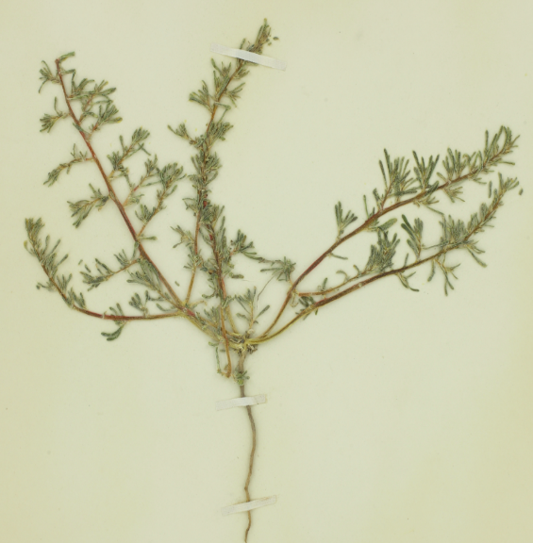
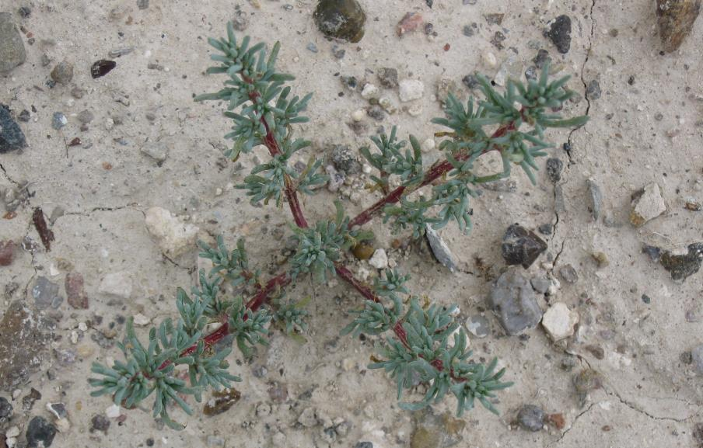
Halogeton
CHENOPODIACEAE
Halogeton glomeratus
Annual |Introduced
Small, annual herbaceous plant
Several branches arise from center of plant
Stems curve outward & upward from base
Stems often turn red as they mature

Slide 6







Slide 7
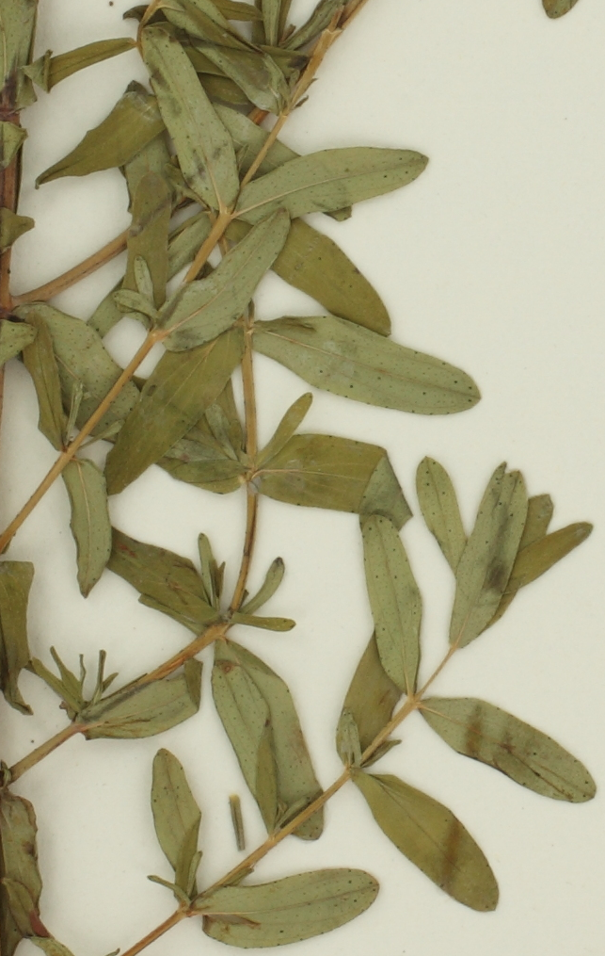
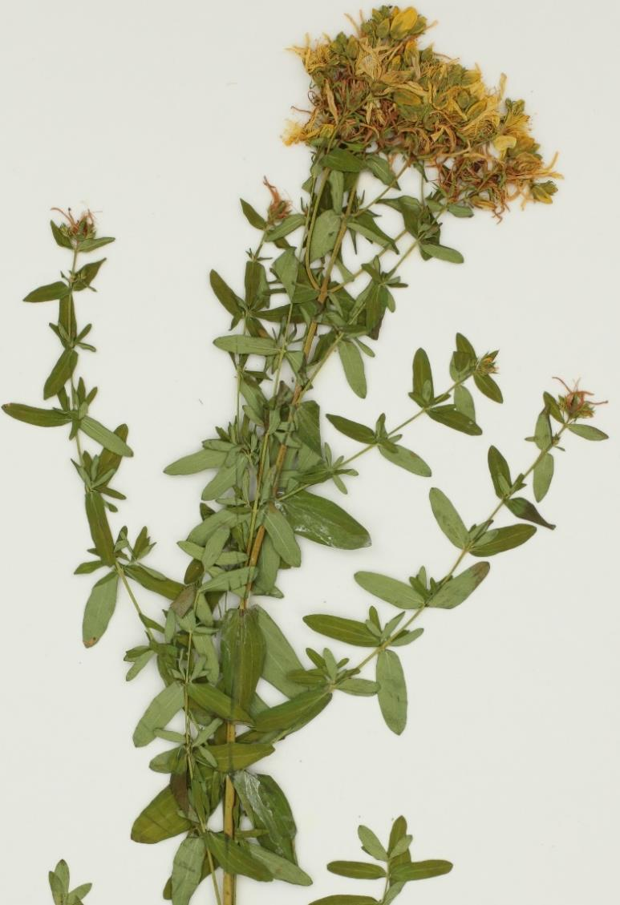

Slide 8
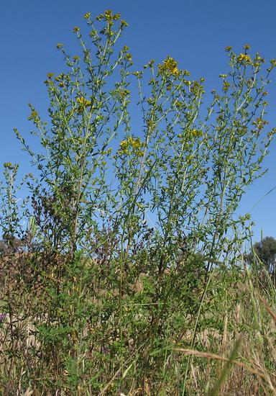
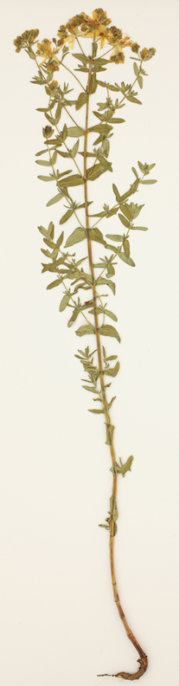
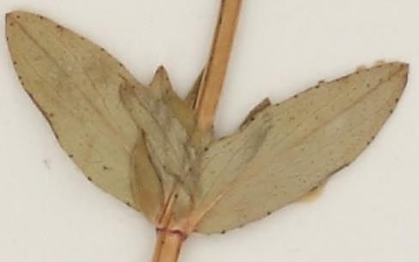
CLUSIACEAE
St. Johnswort
Hypericum perforatum
Perennial | Introduced
    Perennial forb grows up to 3 ft. tall
    Rhizomatous -forms dense colonies
    Opposite leaves
    Leaves with patches look “perforated”
Harry Rose

Slide 9
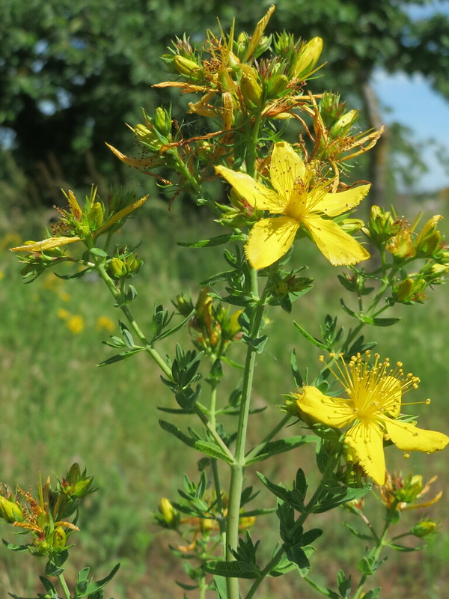
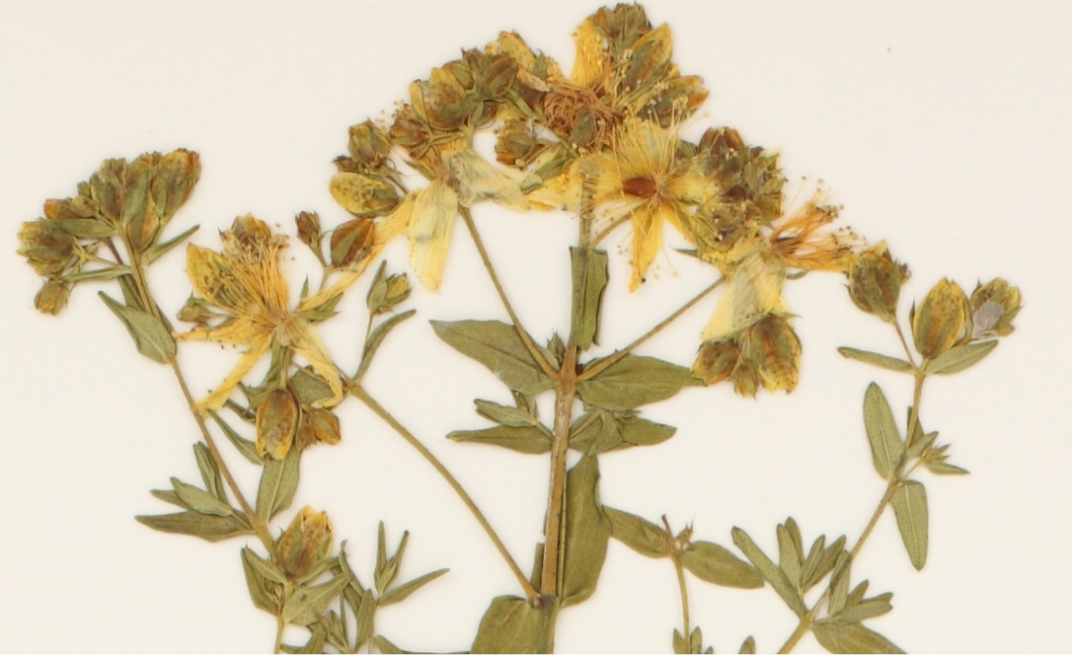
CLUSIACEAE
St. Johnswort
Hypericum perforatum
Perennial | Introduced
    25-100 flowers per stem
    Yellow to yellow-orange symmetrical flowers
    5 petals, many stamens
Andreas Rockstein

Slide 10
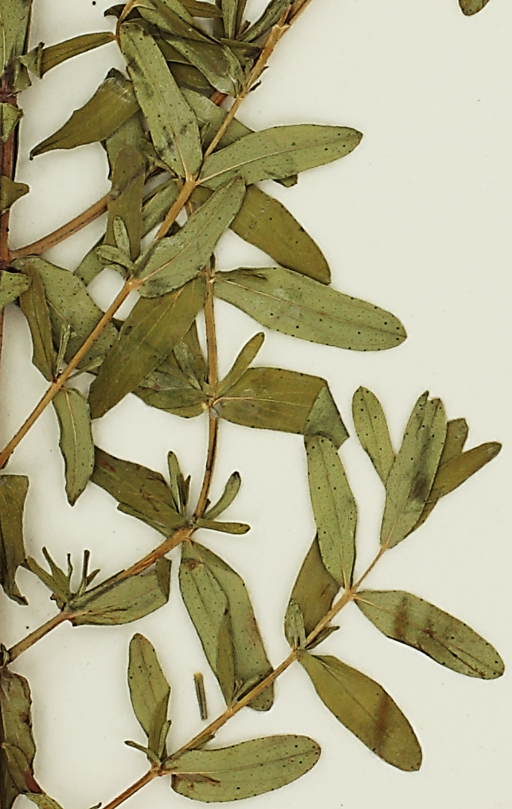
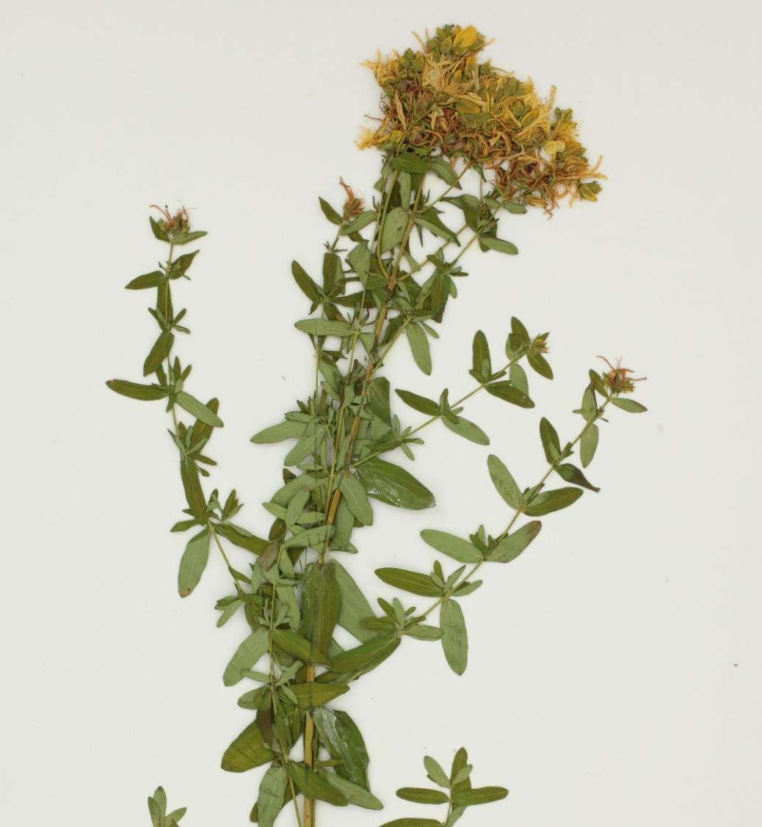





Slide 11
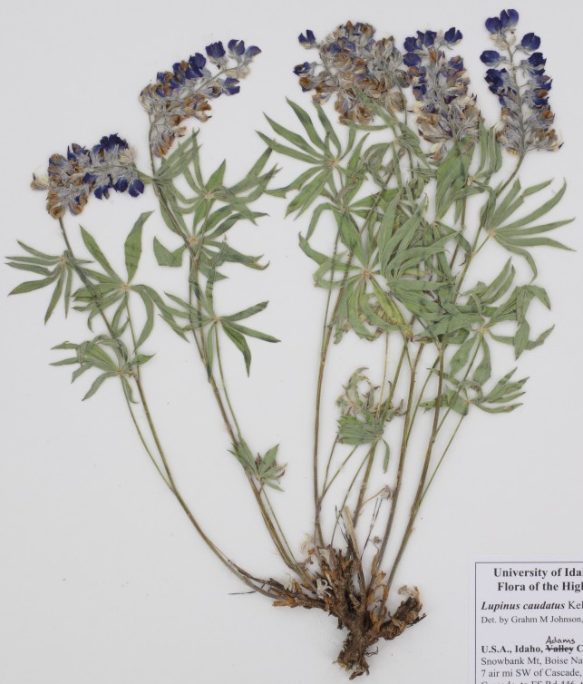
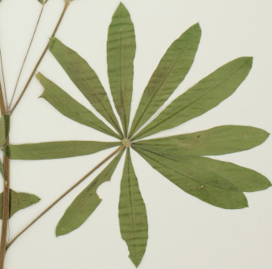

Slide 12
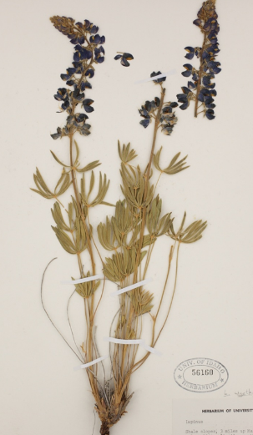
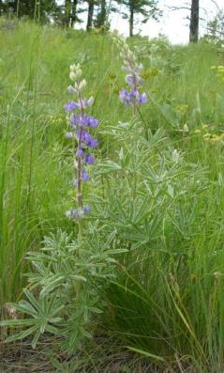
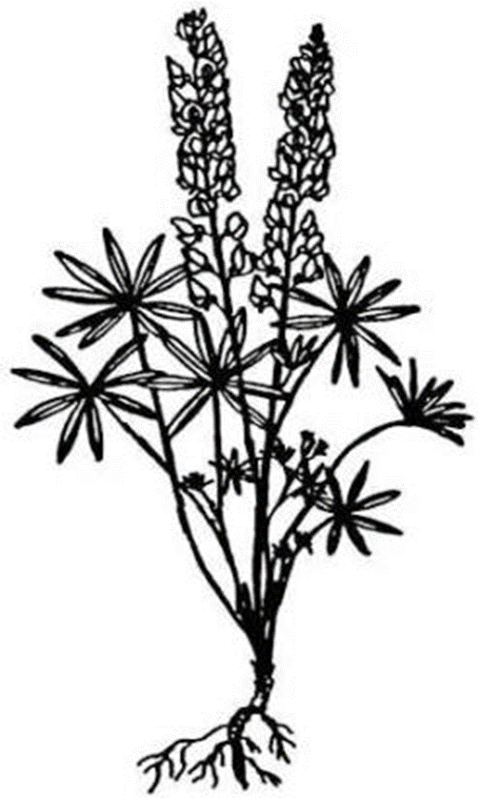
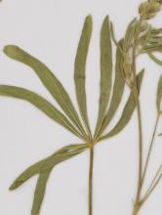
FABACEAE
Tailcup Lupine
Lupinus caudatus
Perennial | Native
  Forb 1 to 2 feet tall
  Mostly basal leaves
  Leaves palmately compound
J. Peterson

Slide 13
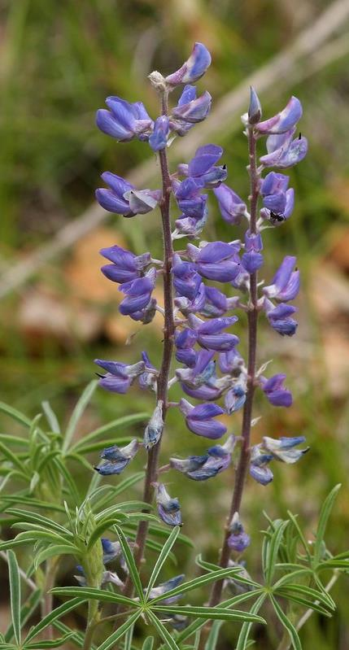
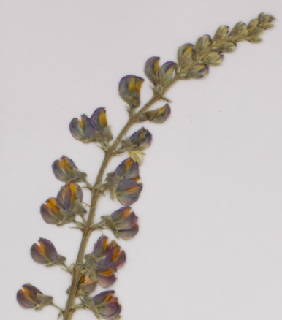
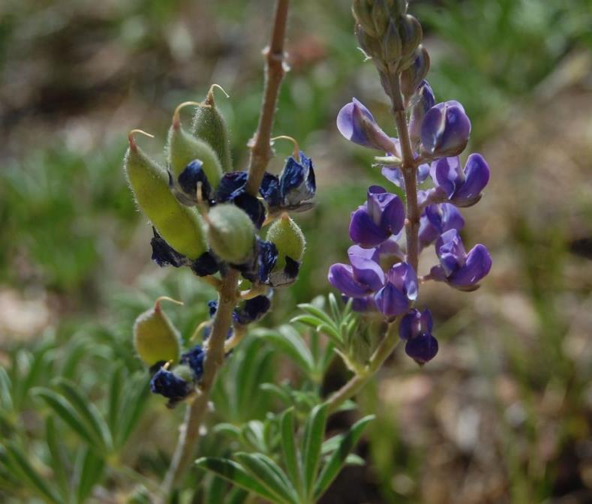
FABACEAE
Tailcup Lupine
Lupinus caudatus
Perennial | Native
  Inflorescence is a raceme
  Irregular blue flowers – white or yellow centers
  Swelling at base = tail
Kirstin Olmon
J. N. Stuart

Slide 14









Slide 15
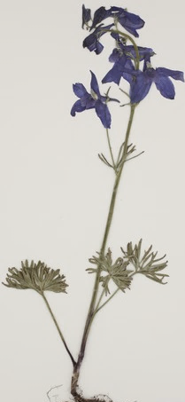
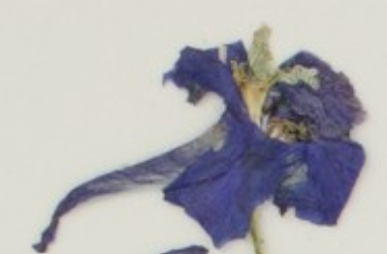

Slide 16
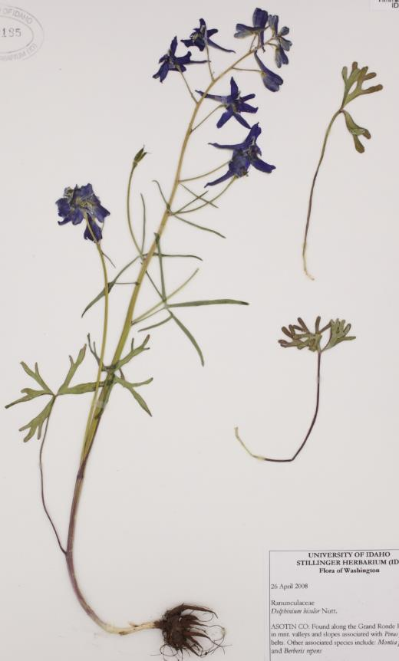
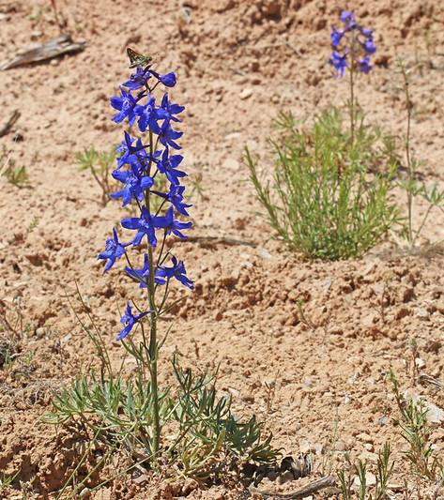
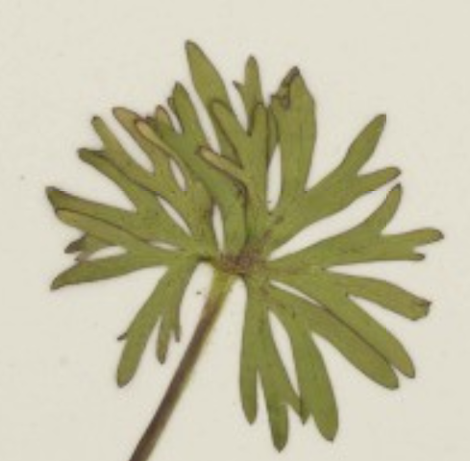
RANUNCULACEAE
Low Larkspur
Delphinium bicolor
Perennial | Native
  About 4 inches to 2 feet tall
  Leaves palmately lobed
Andrey Zharkikh

Slide 17
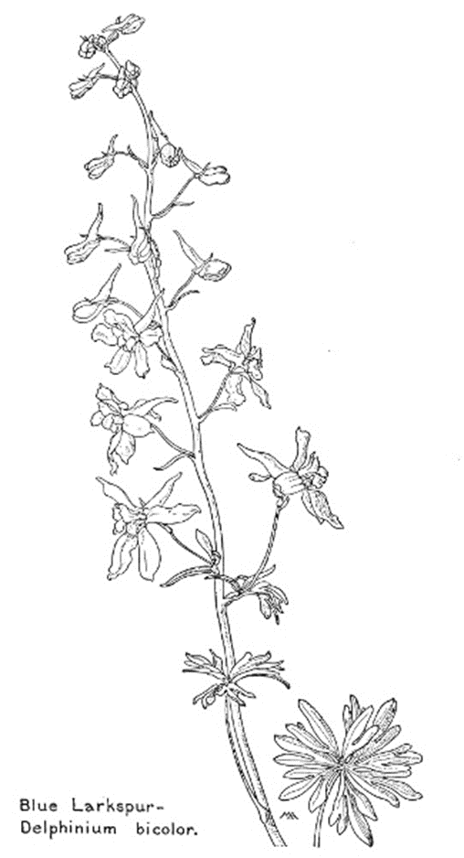
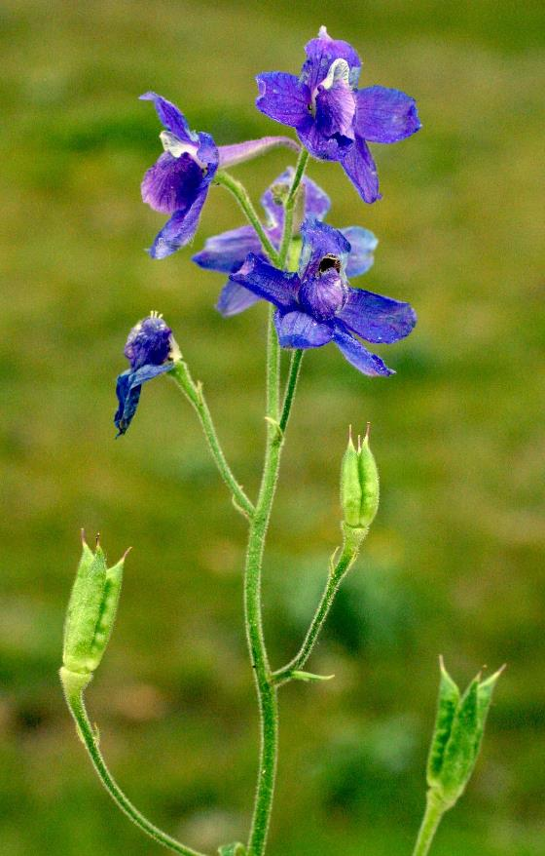
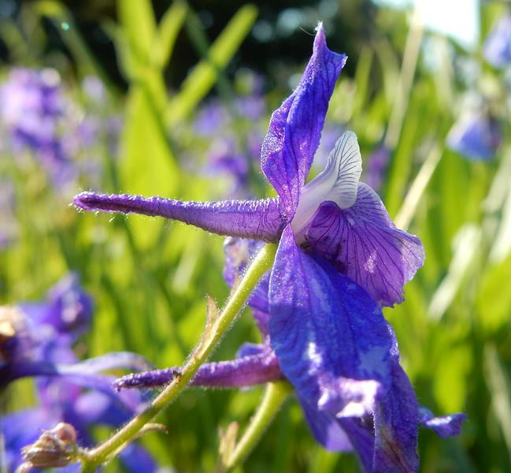
RANUNCULACEAE
Low Larkspur
Delphinium bicolor
Perennial | Native
  Flowers on long racemes
  Dark bluish‐purple, with spurs
Matt Lavin
Paul Rothrock
Margaret Armstrong (www.gutenberg.org)

Slide 18







Slide 19
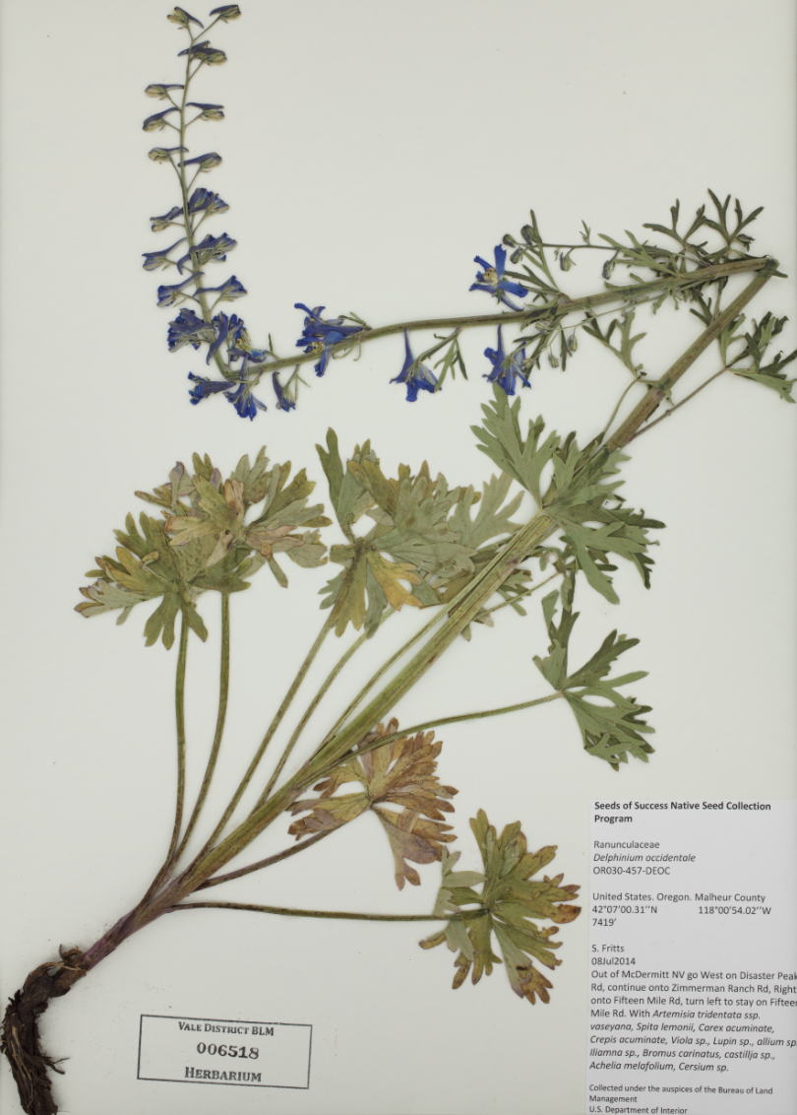
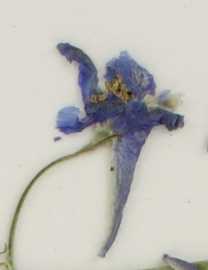

Slide 20
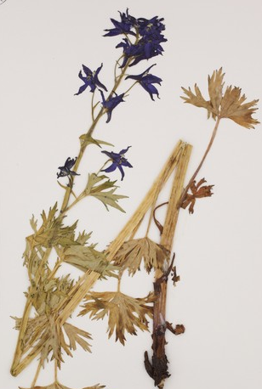
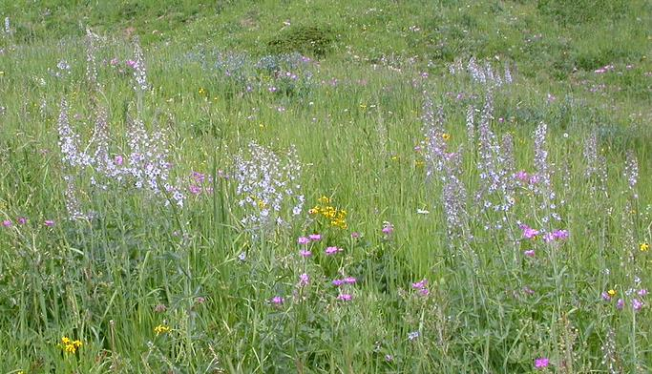
RANUNCULACEAE
Tall Larkspur
Delphinium occidentale
Perennial | Native
  Forb grows 2 to 6 feet tall
  Thick stem
  Palmately divided leaves - ragged (cleft) margins

Slide 21
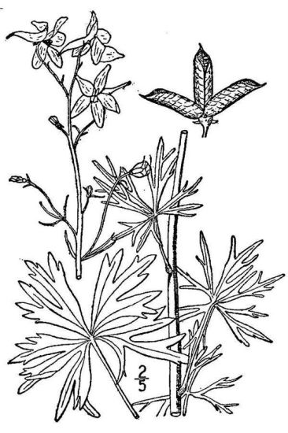
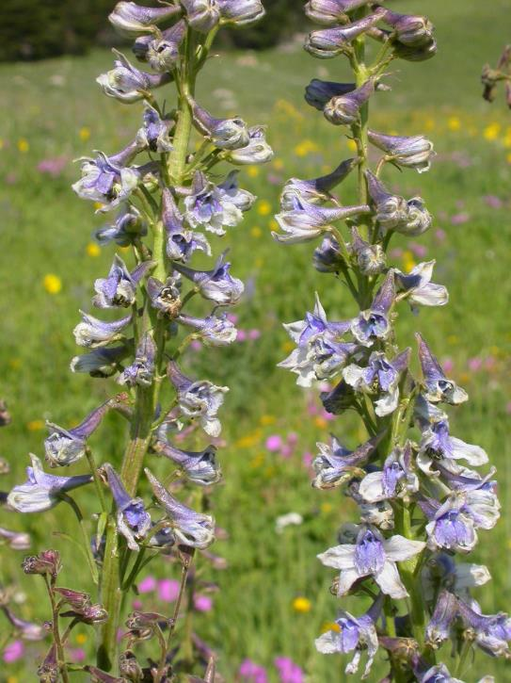
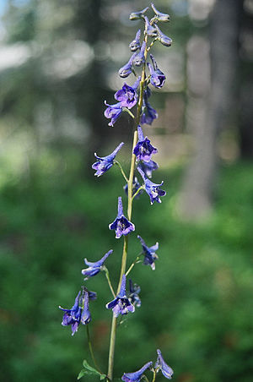
RANUNCULACEAE
Tall Larkspur
Delphinium occidentale
Perennial | Native
  Raceme inflorescence
  Irregular blue flower with spur

Slide 22

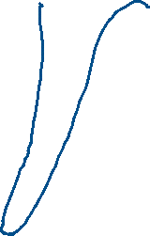





Slide 23
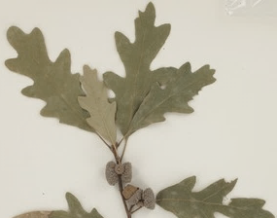
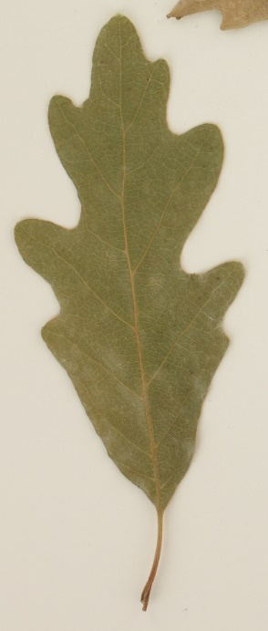

Slide 24
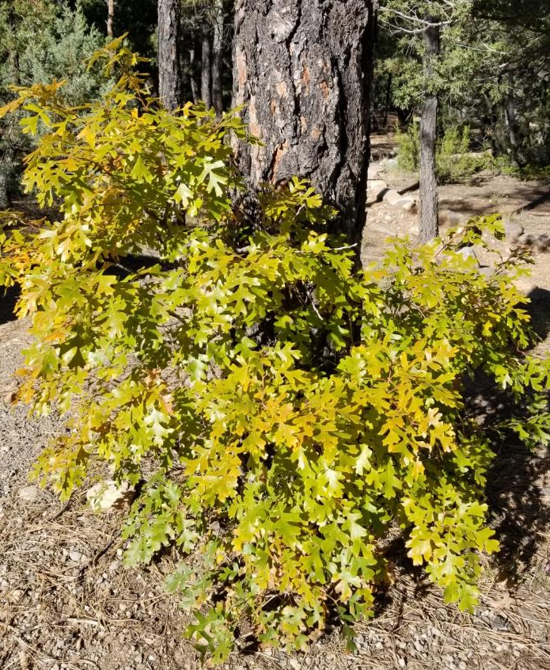
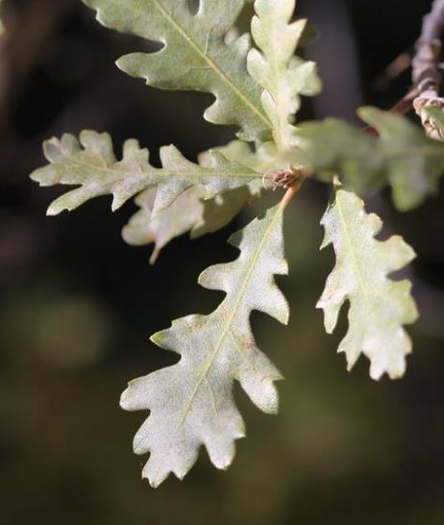
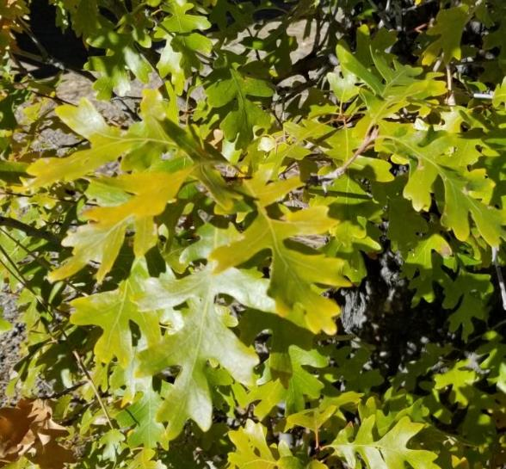
FAGACEAE
Gambel Oak
Quercus gambelii
Perennial | Native
Shrub or small tree usually growing indense stands
Bark is light gray to white
Deeply 5-9 lobed, oval outline
Andrey Zharkikh
K. Launchbaugh
K. Launchbaugh

Slide 25


FAGACEAE
Gambel Oak
Quercus gambelii
Perennial | Native
Acorn cup encloses 1/4 –1/3 of nut
Andrey Zharkikh
Andrey Zharkikh

Slide 26




Slide 27



Slide 28



PINACEAE
Ponderosa Pine
Pinus pondorosa
Perennial | Native
Tree can grow up to 200 ft tall
Cory bark

Slide 29



PINACEAE
Ponderosa Pine
Pinus pondorosa
Perennial | Native
Leave are needle grouped 3 /fascicle
Cones rounded with short prickles on tisp

Slide 30





Slide 31



Slide 32



SENECIONEAE
Gray Horsebrush
Tetradymia canescens
Perennial | Native
Highly branched shrub 1-3 feet tall
Linear gray leaves & yellow flowers

Slide 33



SENECIONEAE
Gray Horsebrush
Tetradymia canescens
Perennial | Native
4 bracts around disk flowers

Slide 34



Slide 35
In Summary – Plants we will learn in class have these toxic properties:
Halogeton has oxalates that are deadly to sheep.
St. Johnswort can treat depression and cause photosensitization.
Tailcup Lupine has alkaloids that can cause crooked calve disease (birth defects)
Low and Tall Larkspur both have alkaloids that deadly to cattle and sheep.
  Low larkspur had more toxins per gram.
  Tall Larkspur kills more livestock because it has large green leaves that are tasty and look good to eat.
Gabel Oak, like most oaks, have tannins whicd reduce protein digestion.
Ponderosa Pine has a mixture of toxins that can cause abortions in cattle.
Gray Horsebrush toxins causes photosensitization and swelling such as "big head" in sheep.

Slide 36
Toxic Rangeland Plants
J. Peterson
K. Launchbuagh
Sheri Hagwood - BLM
Rusty Clark

