Slide 1
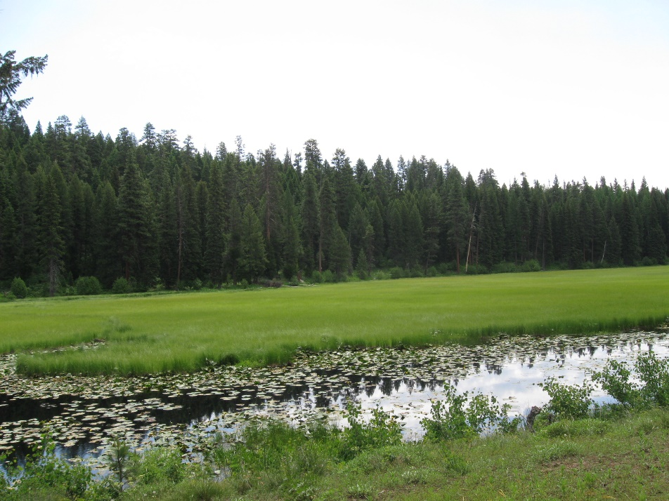
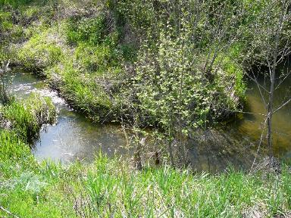
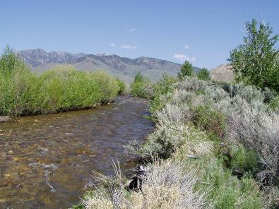
Riparian Plants
K.Launchbaugh
K. Launchbaugh
Juley Hankins-Smith
Rangeland Ecology & 252 – Wildland Plant Identification

Slide 2
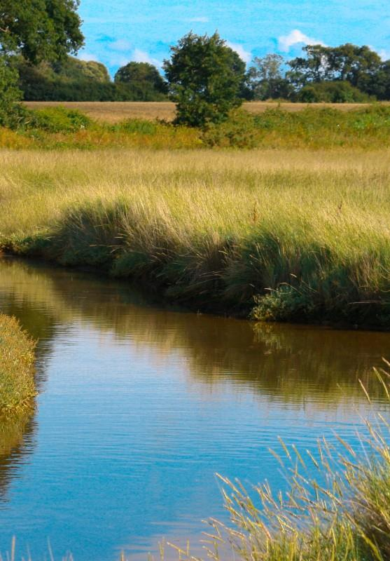
Riparian Plants
Plants are underestimated for potential to “control” stream
  Large Woody Debris or Rocks and Boulders usually considered first
It’s the Vegetation Stupid!
Plant mold the stream to fit the power of the water
Notes from Ervin Cowley – Retired Idaho BLM

Slide 3
Root Length

Slide 4
Channel Stability Rating

Slide 5
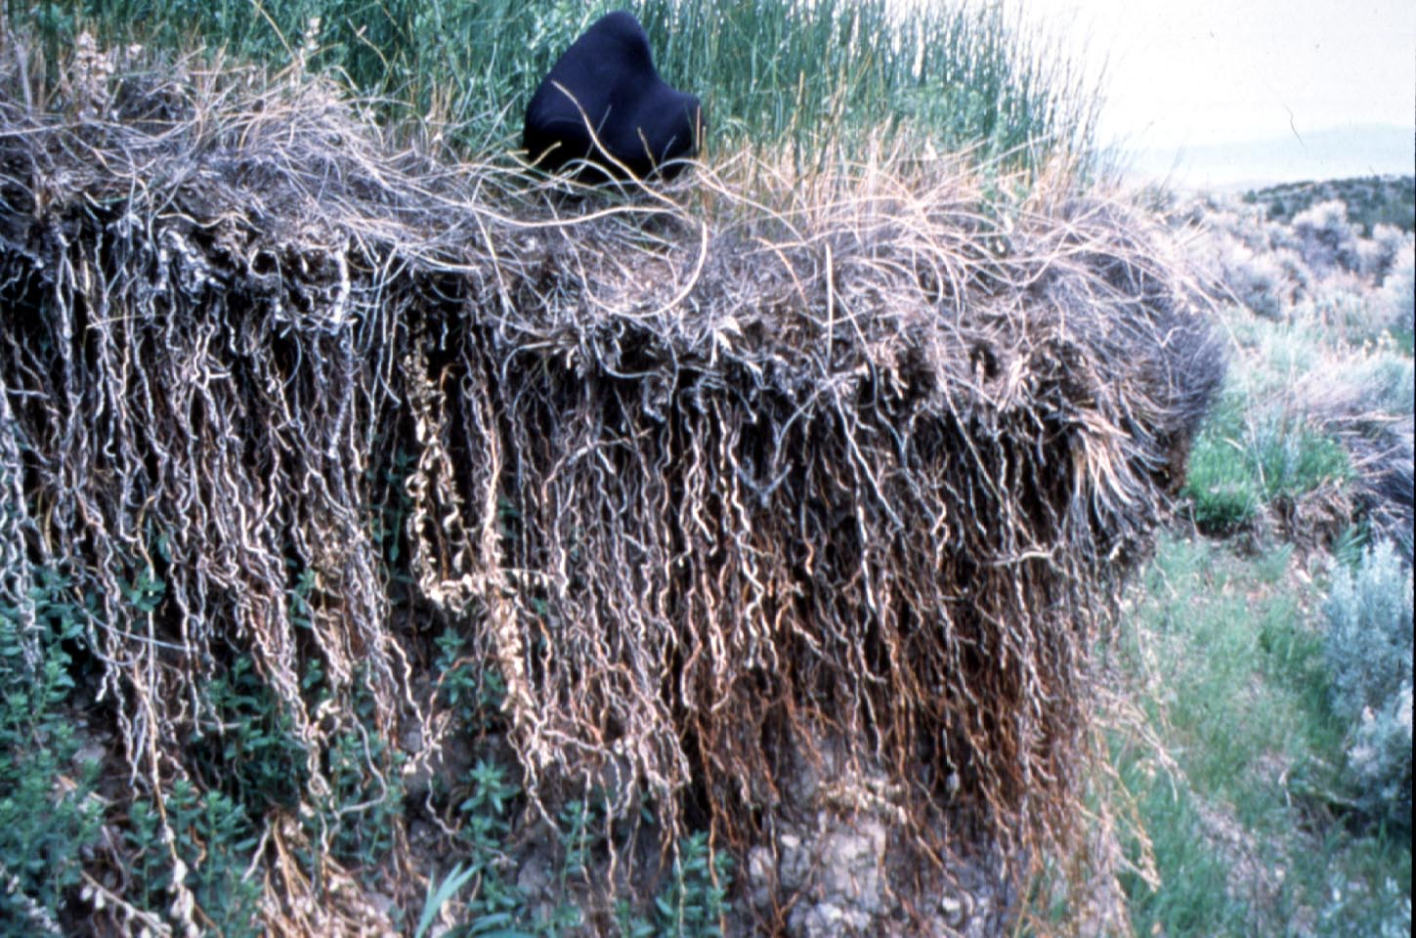
Baltic Rush Roots

Slide 6
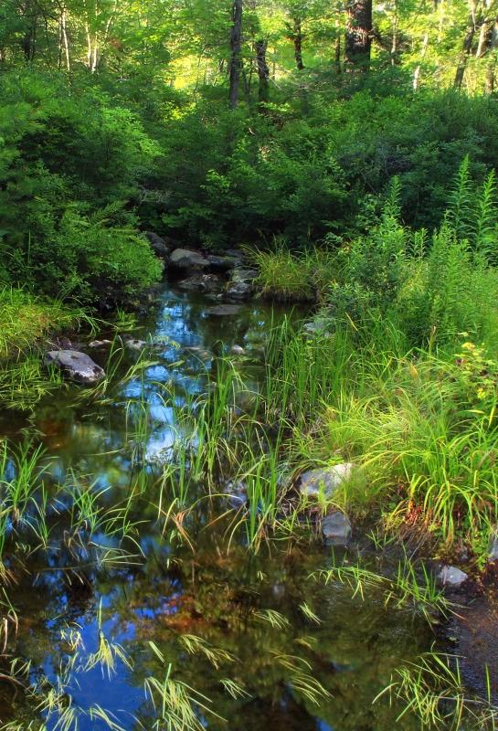
Riparian/Wetland Vegetation Functional Groups
Stabilizers
Colonizers
Increasers/Invaders

Slide 7

Stabilizer Group
Establish along streams, rivers, lakes, ponds, springs, & seeps
Strong, fibrous, deep root system
Rhizomatous
Provide protection against water’s energy

Slide 8
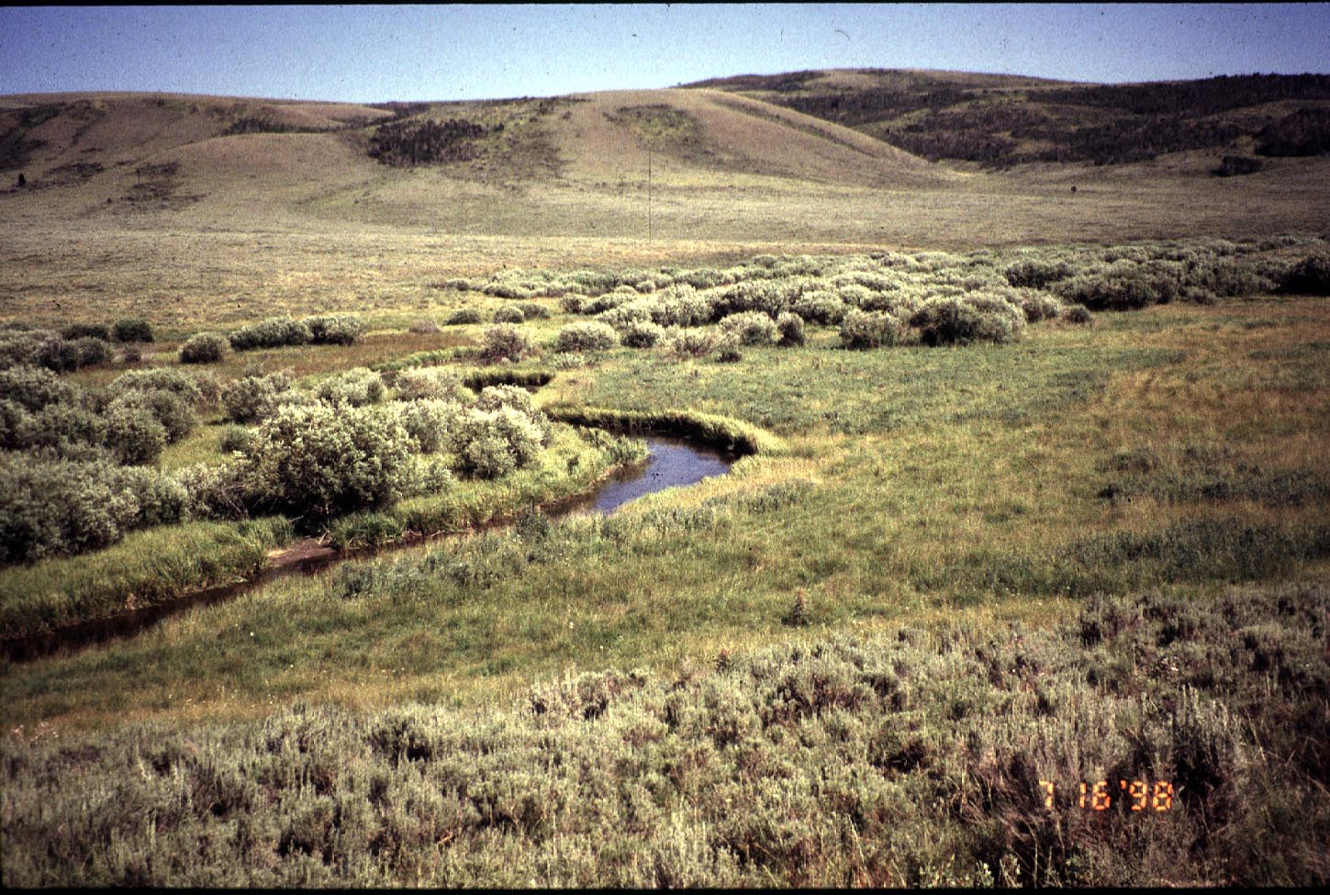
Stabilizer Species

Slide 9
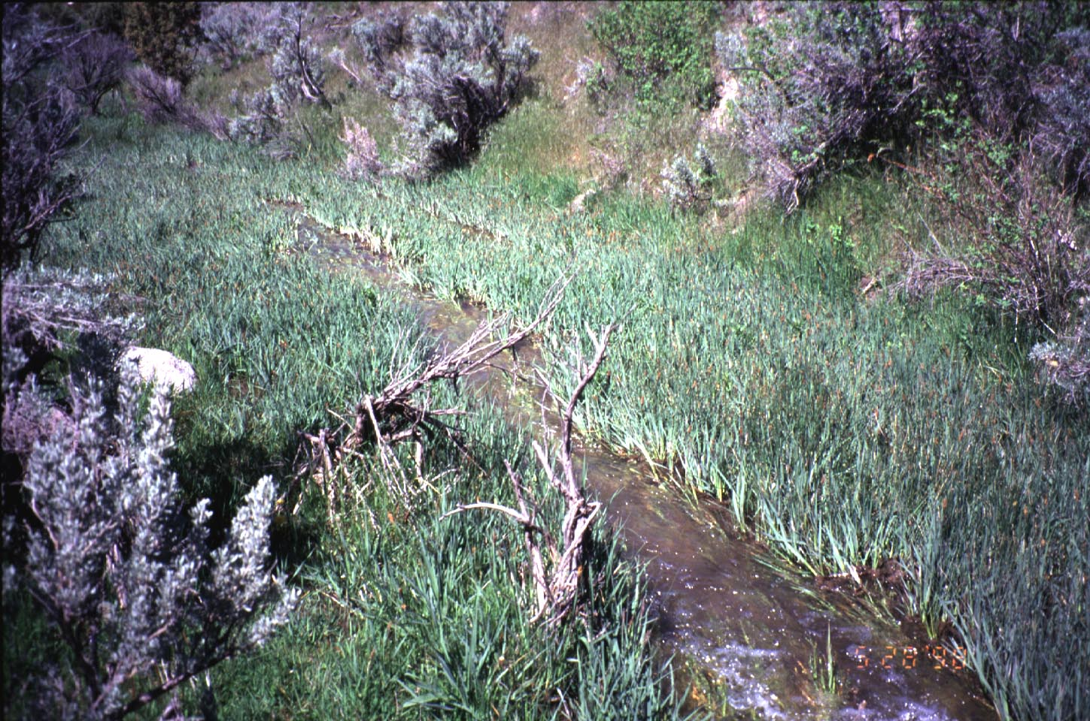
Nebraska Sedge
Emery Creek

Slide 10
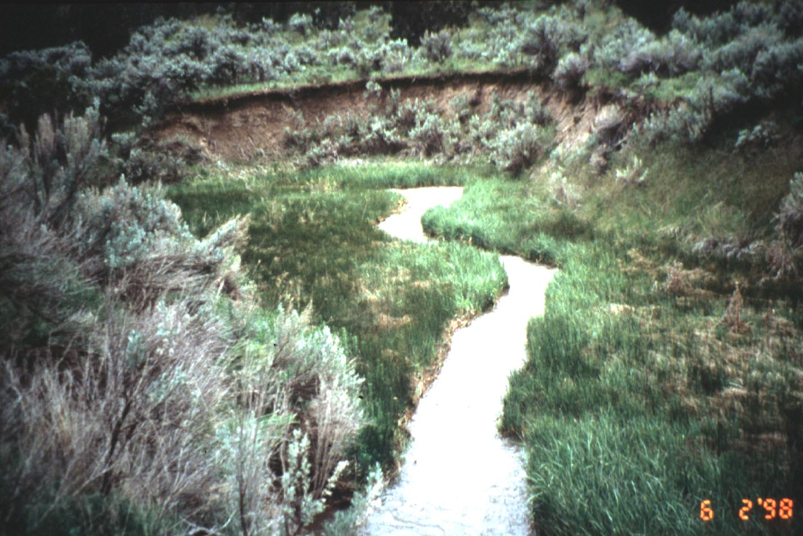
Baltic Rush
Birch Creek

Slide 11
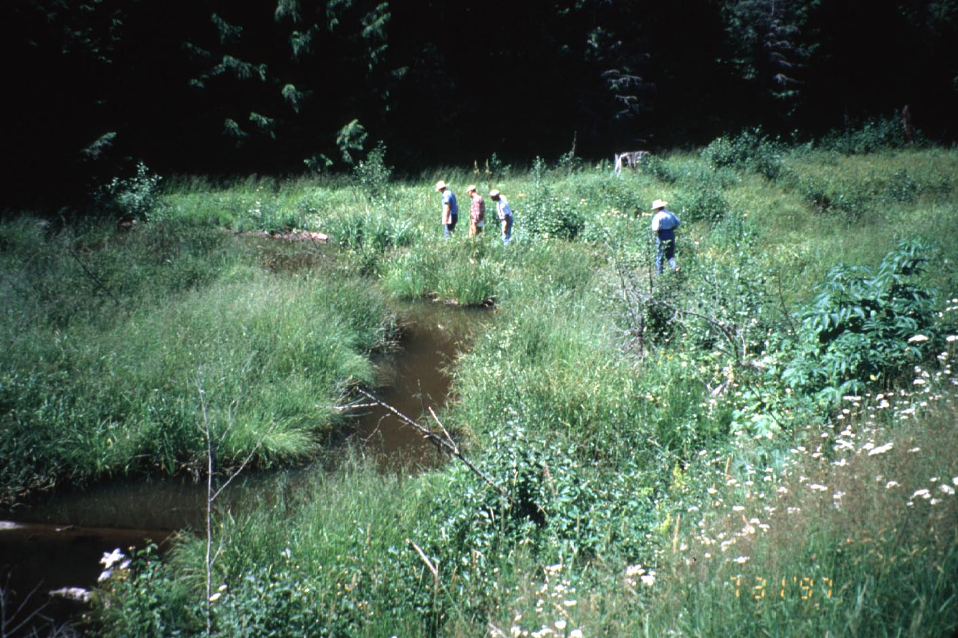
Bluejoint Reedgrass
Little Sand Creek

Slide 12
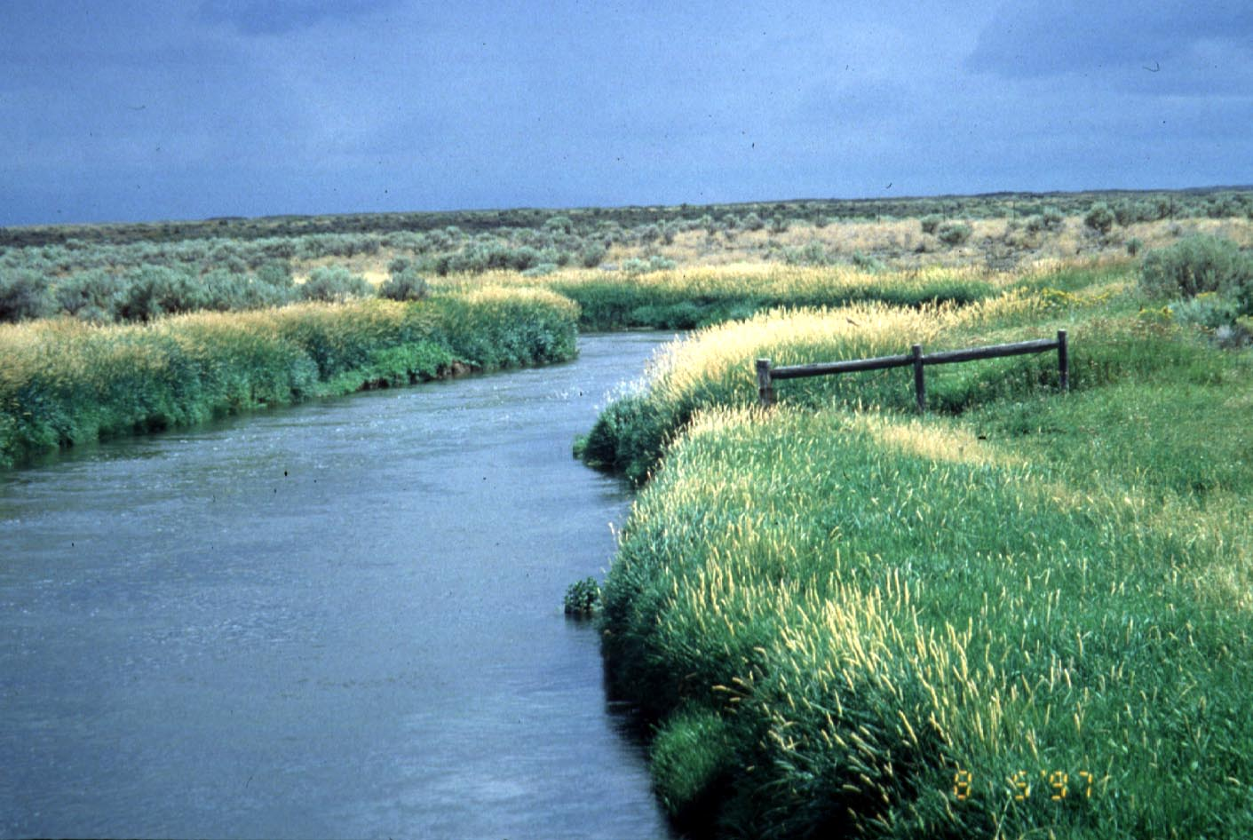
Reed Canary Grass
Little Wood River

Slide 13
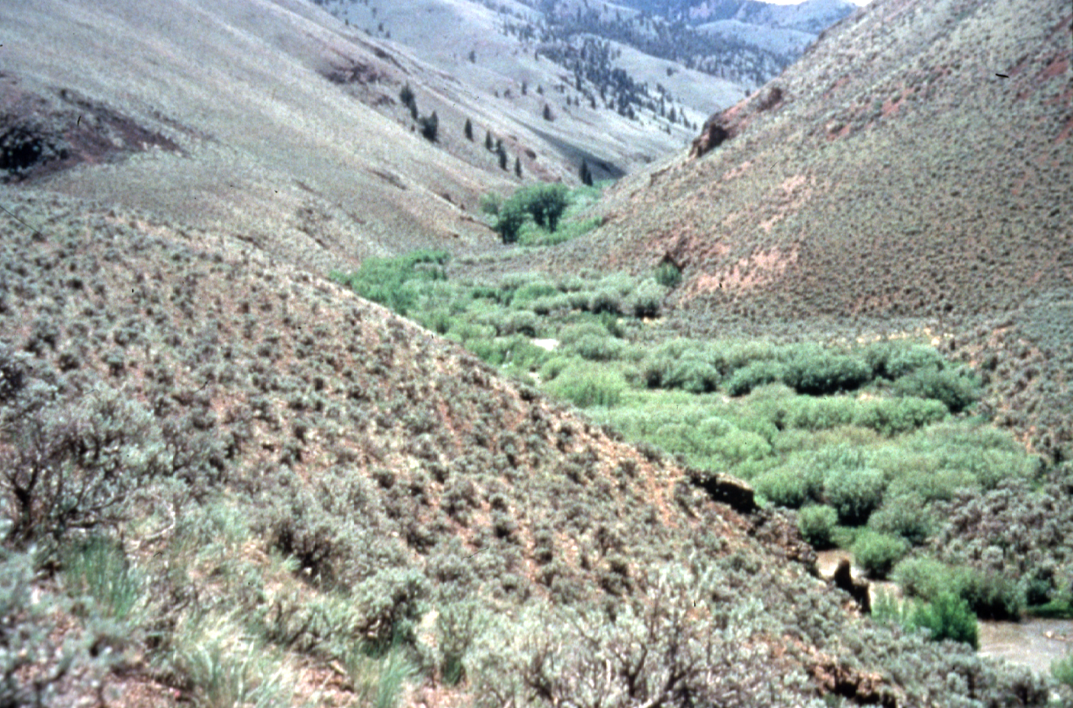
Woody Stabilizer Species
(willlows)

Slide 14
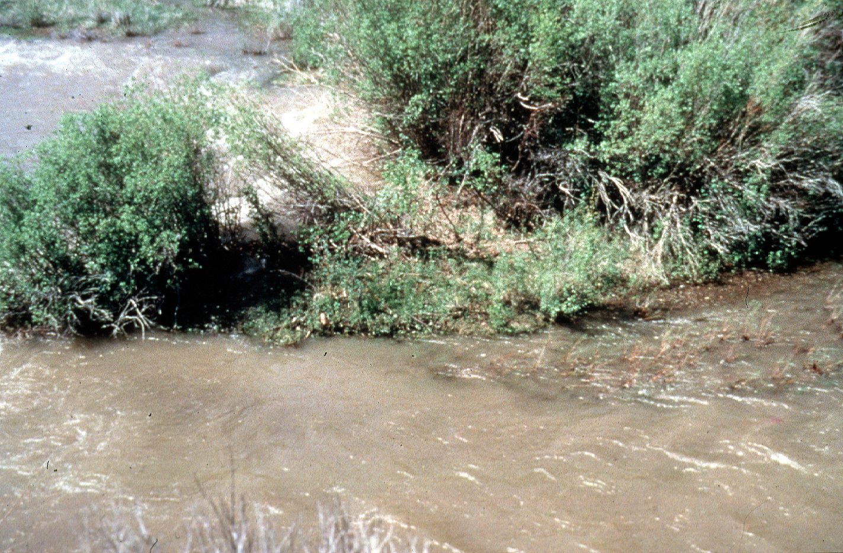
Woody plant roots hold streambanks

Slide 15
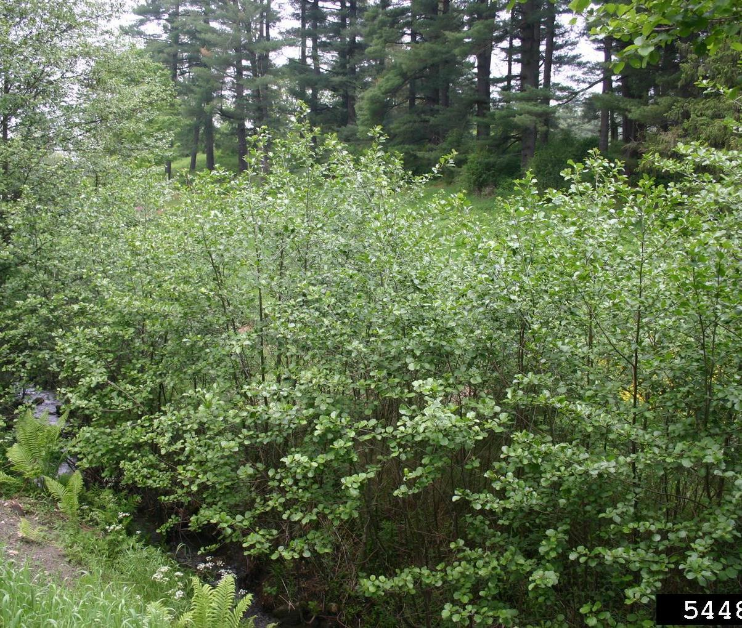
Alder shrubs stabilize stream

Slide 16
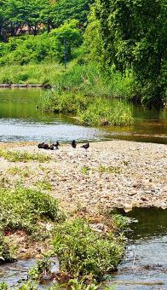
Colonizers Group
Usually, first plants to occupy a site
Critical for recovery and maintenance of stream channels.
Establish on:
  freshly deposited soil
  shallow open water
  barren areas
Root systems:
  stoloniferous or rhizomatous
  shallow and relatively weak

Slide 17
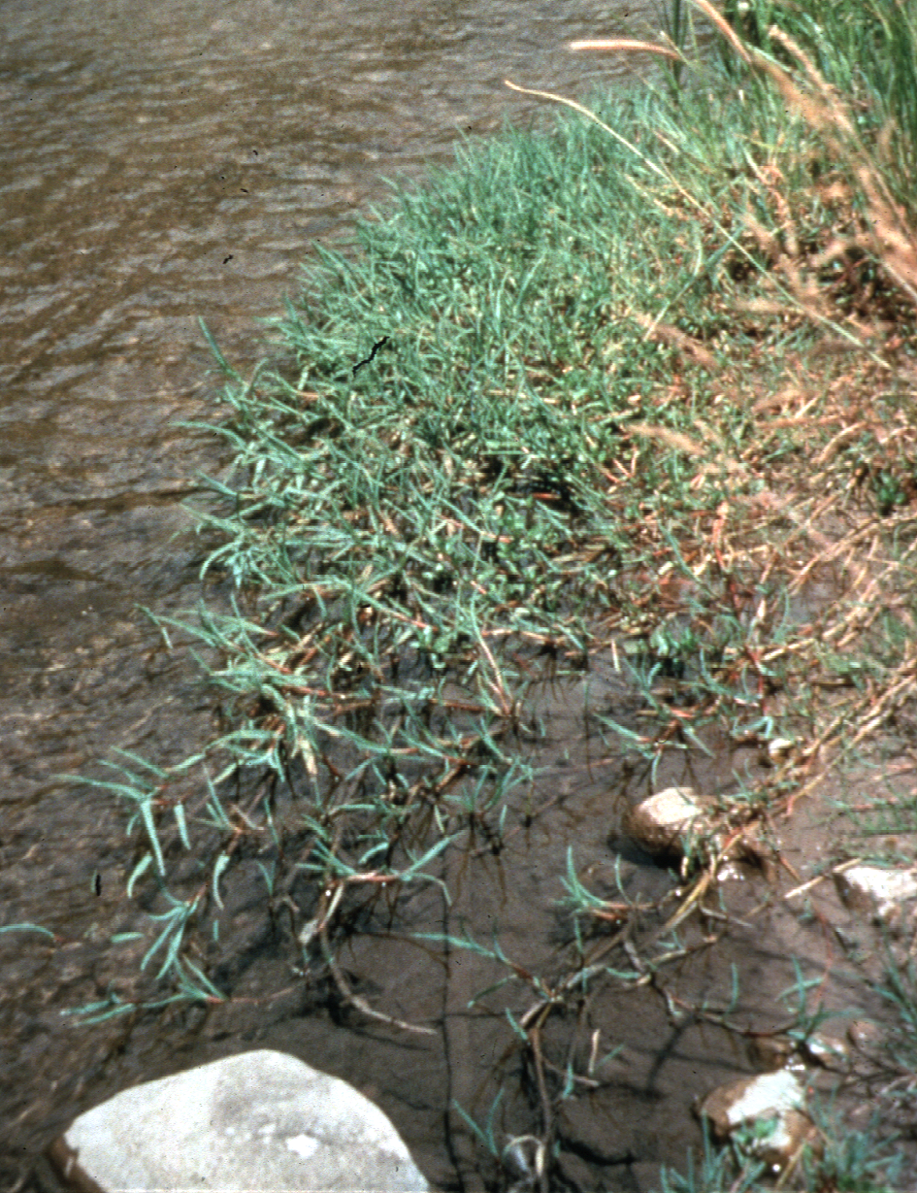
Colonizer
Brook Grass

Slide 18
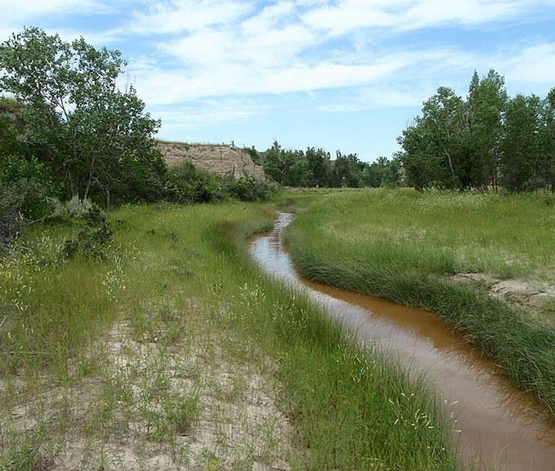
Rush plants colonizing stream

Slide 19
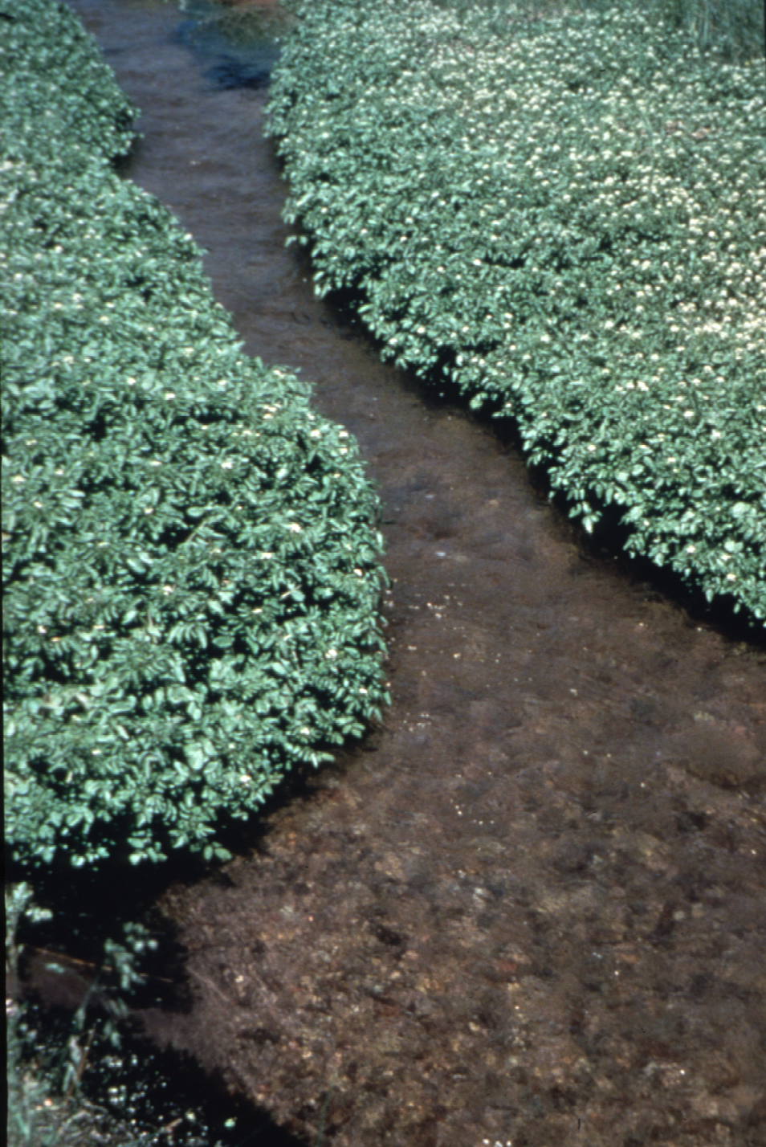
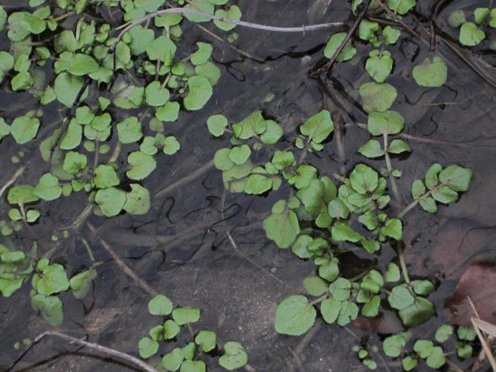
Water Cress

Slide 20
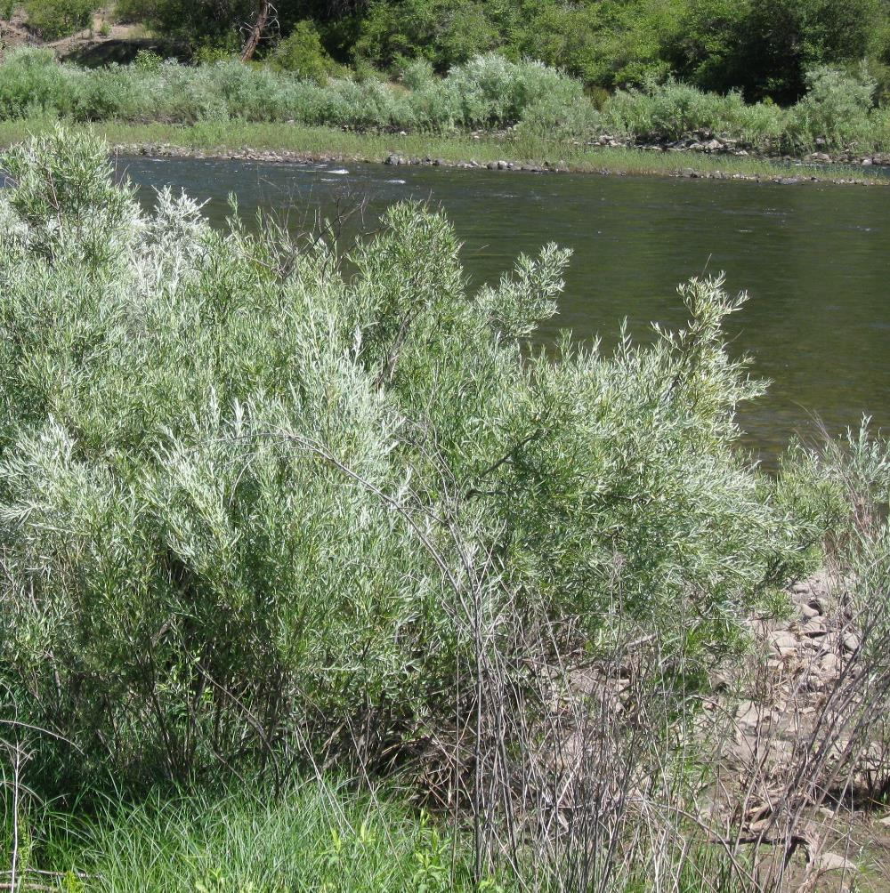
Coyote Willow colonizing stream

Slide 21
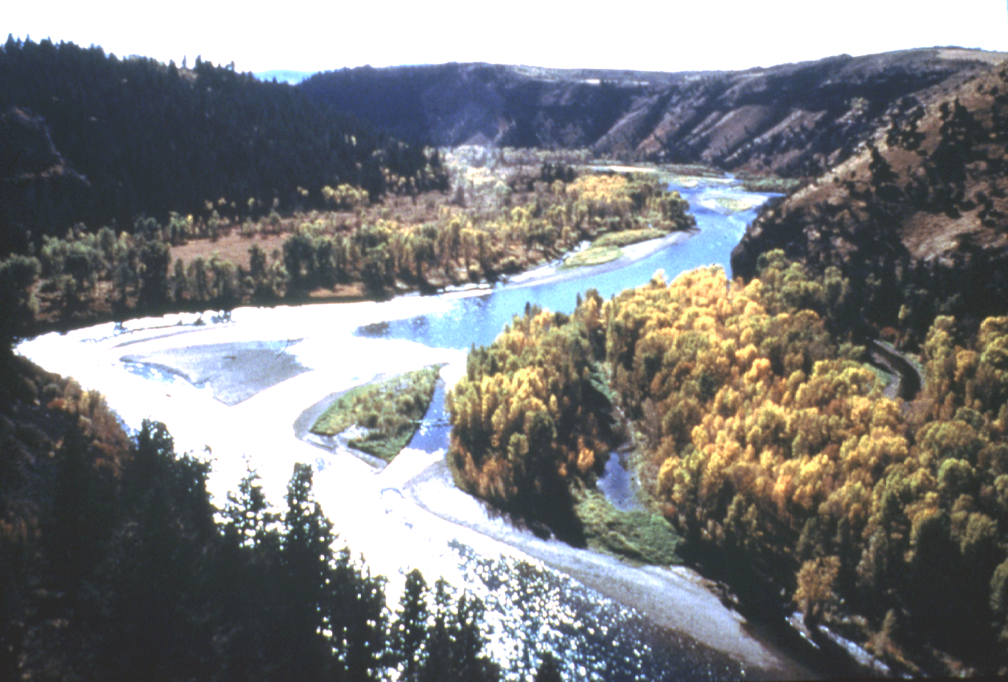
Cottonwood
South Fork Snake River

Slide 22
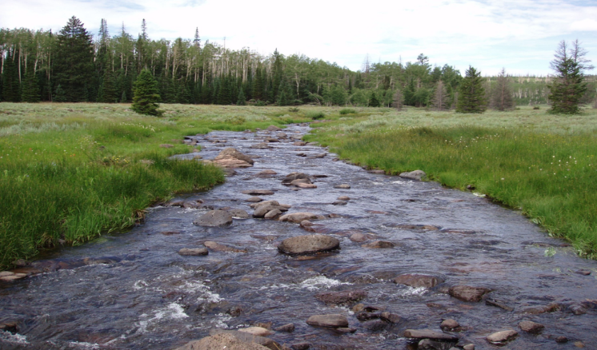
Healthy or Not?
Mammoth Creek, Utah – PFC Presentation 2011

Slide 23
Healthy Riparian Area
Stems and roots protect and stabilize banks
Elevated saturated zone -- increased subsurface storage of water
Increased summer streamflow
Cooler water in summer, warmer
and less icy in winter
Improved habitat for fish and other
aquatic organisms
High forage production and quality
High diversity of wildlife habitat
K.Launchbaugh

Slide 24
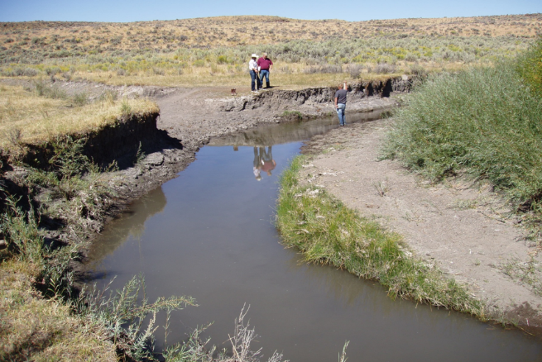
Healthy or Not Healthy?
N. Fork Humboldt River – PFC Presentation 2011

Slide 25
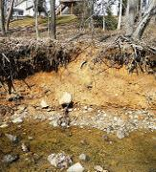
Degraded Riparian Area
Little vegetation to protect & stabilize banks
Lowered saturated zone
Little or no summer stream flow
Warm water in summer & icy water in winter
Poor habitat for fish and other aquatic organisms
Low forage production & quality
Low diversity of wildlife habitat
DEP Montgomery County, MD(flickr)

Slide 26
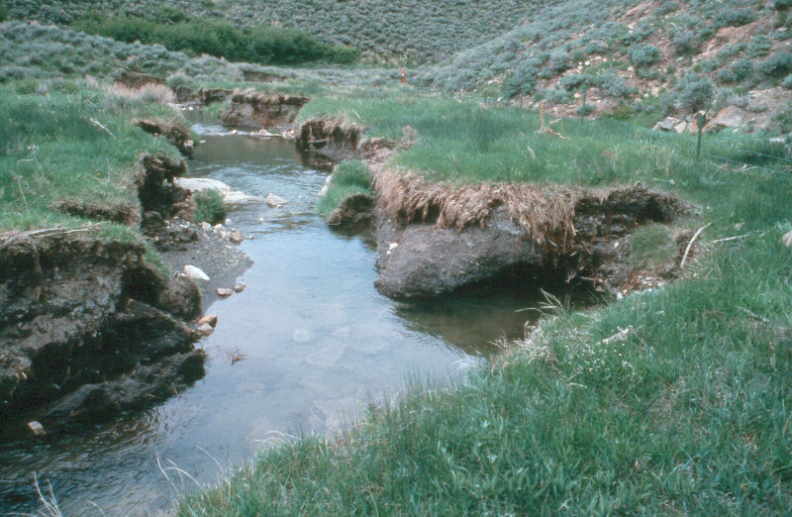
Potential for Recovery?
W. Elmore
Notes:
One problem we have is not being able to tell wide varitey of audiences what potential of degraded systems really is. This is a before picture of a stream that has downcut and widened and is ready to recover.

Slide 27
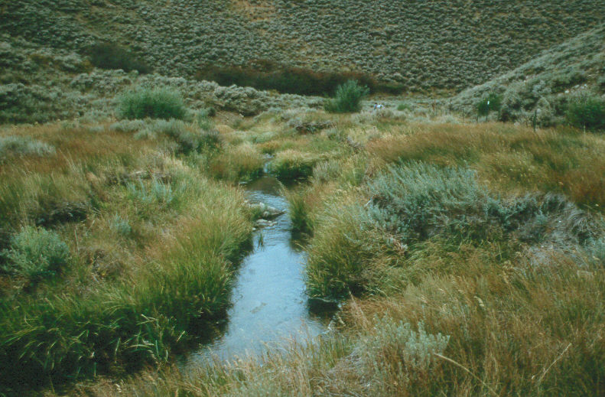
12 years later
W. Elmore
Notes:
This is the after picture 12 years later with a change in management. This is totally natural recovery.

Slide 28
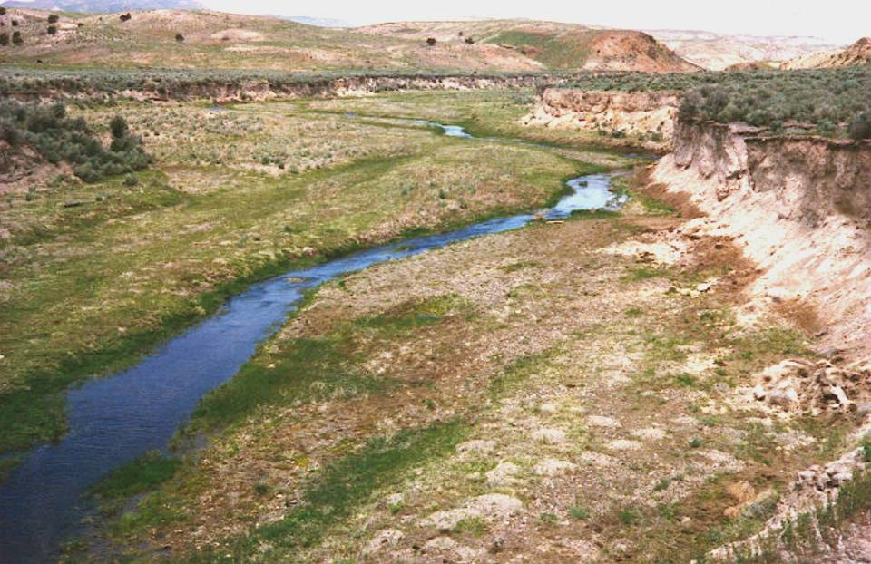
Potential for Recovery?
W. Elmore
Notes:
Another example of before management change. What do you think the potential is for this site.

Slide 29
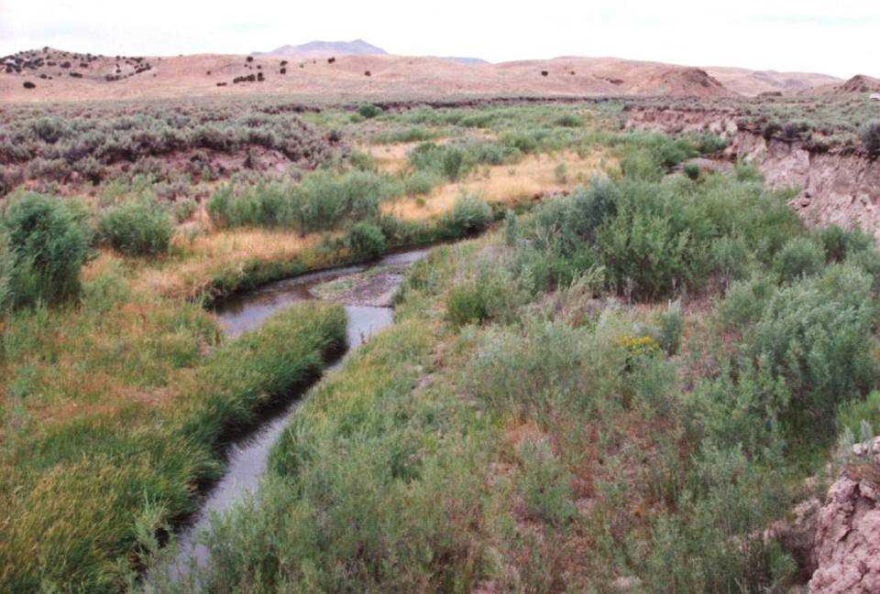
10 years later
W. Elmore
Notes:
Approximately 10 years later. No reduction in livestock numbers only a change in the season of use. Ask what differences so you see between the before and after.

Slide 30
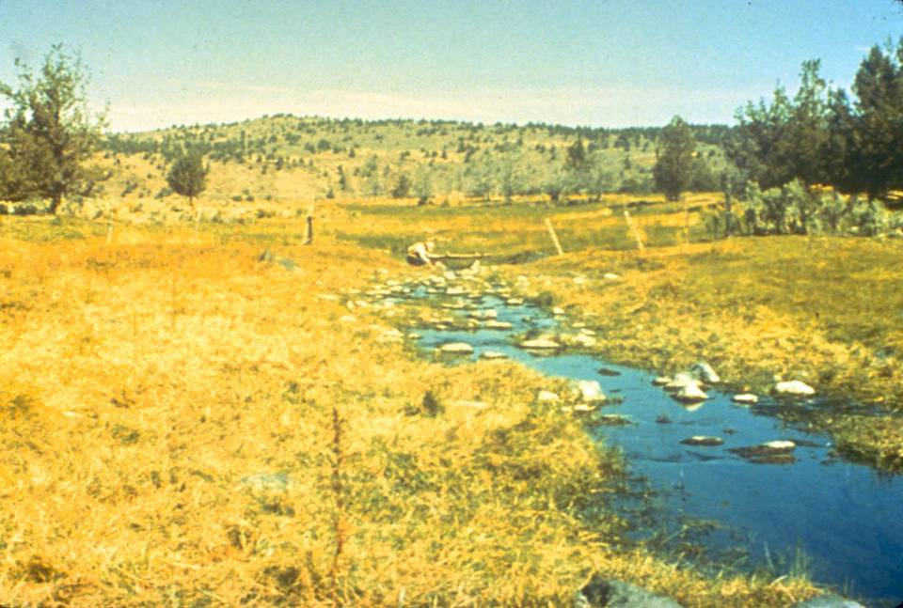
SF Crooked River, OR 1976
Season long use
W. Elmore
Notes:
SF Crooked River, OR 1976
Season long use

Slide 31
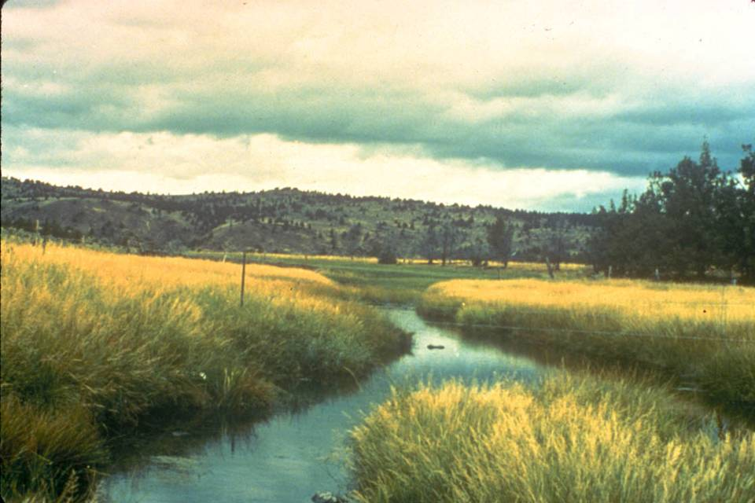
S. Fork Cr. River 1984 after two years of rest followed by early season grazing
8 years later
W. Elmore
Notes:
S. Fork Cr. River 1984 after two years of rest followed by early season grazing. What species would like this benefit from this change and which one would not.

Slide 32
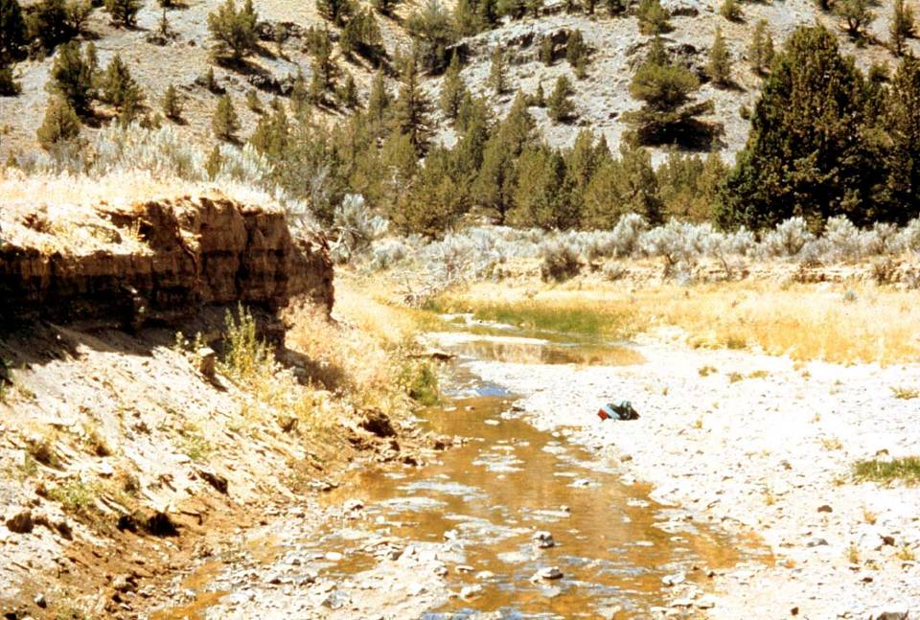
Bear Creek May 1977
W. Elmore
Notes:
Bear Creek was season long grazed for 100+ years. In the 1950’s the willows were sprayed to reduce water use and in 1964 there was a 100+ year event (rain on snow 12-24-64) and the stream downcut and in this photo has widened out. The current livestock use is 25 cows/calves for three months (June, July, Aug) or 75 AUM’s. The vegetation is mostly upland species with some Baltic rush (dark green in center of picture). Uplands are dominated by basin big sagebrush and western juniper. Reference points are the plump juniper on the right and the snag on the left. The juniper in the foreground will be cut before the next photo was taken. The following is 27 years of change on this stream. The management was changed initially to two years of rest, followed by late winter (mid Feb) to early spring (mid April) grazing.

Slide 33
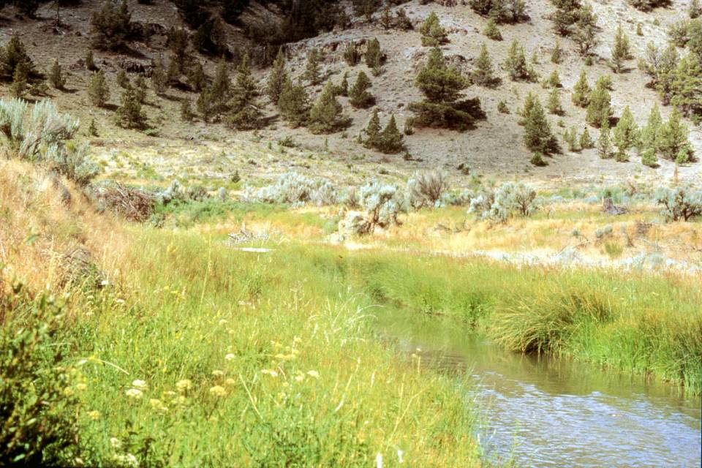
Bear Creek Aug 1986
9 years
W. Elmore
Notes:
A flood plain is developing on both sides of the stream and vegetation has changed to a more mesic (water loving) mix of plants that includes Nebraska sedge, Small-fruit bulrush, beaked sedge, spike rush, brook grass, three square bulrush, and some reed canarygrass.

Slide 34
Riparian Plants
K.Launchbaugh
K. Launchbaugh
Juley Hankins-Smith
Rangeland Ecology & 252 – Wildland Plant Identification

