Slide 1
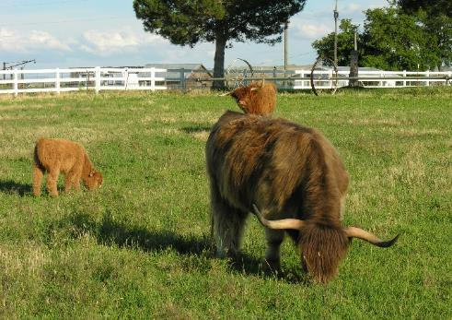
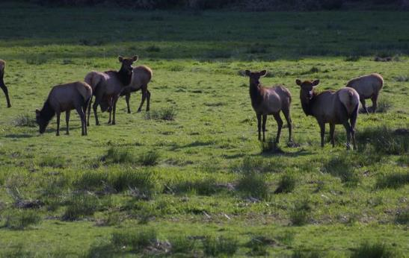
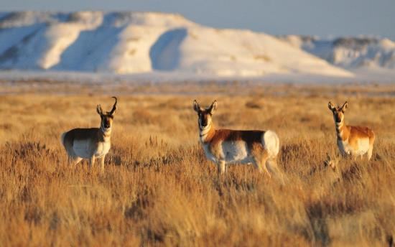
Herbivore Intake
K. Launchbaugh
BLM
Tom Koerner USFWS
Integrated Rangeland Management

Slide 2
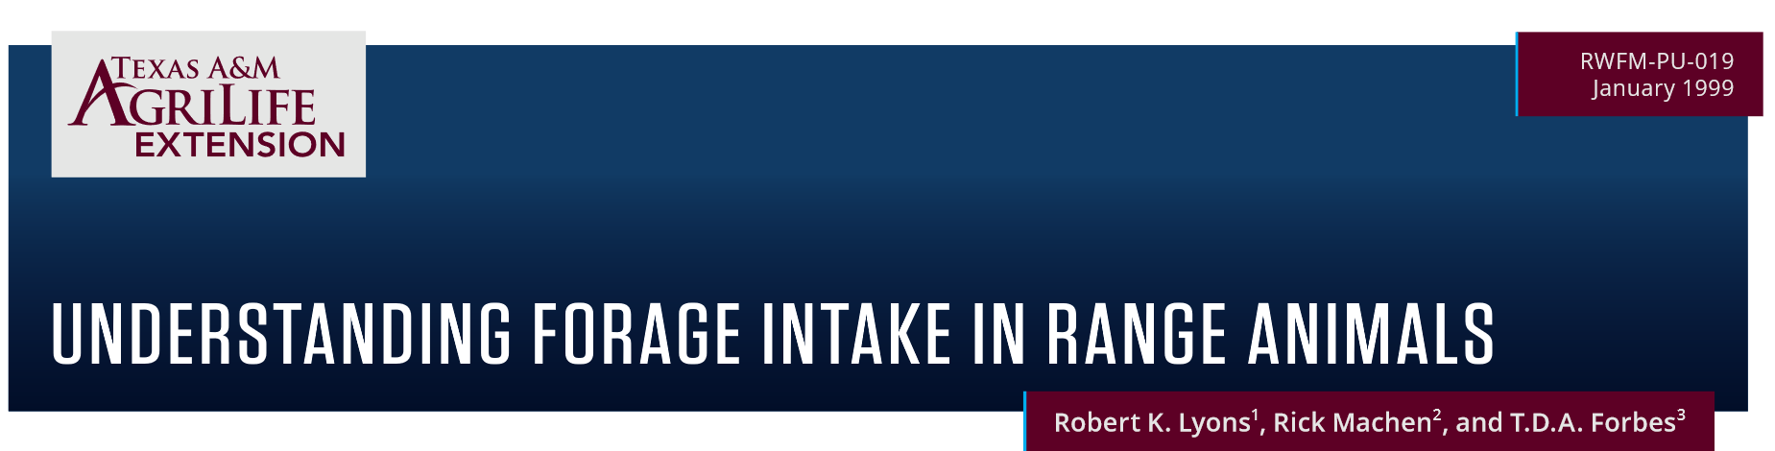
Factors Affection Herbivore Intake
https://cdn-de.agrilife.org/extension/departments/rwfm/rwfm-pu-019/publications/files/understanding-forage-intake-in-range-animals.pdf

Slide 3
Factors Affection Herbivore Intake
Herbivore Species & Size
Physiological State of Herbivore
Forage Quality
Forage Water Content
Forage Characteristics & Foraging Behavior
Supplemental Feeding
Standing Crop
Environmental Factors
Herbivore
Forage
Management & Environment

Slide 4
Herbivore Species
Ruminant vs Hind-gut
1) Cattle eat ~ 2.5% of body weight per day
  1,000 lb cow eats about 25 pounds per day
3) Cattle can digest rumen microbes for protein and vitamin B
  Rumen microbes supply 50% to 80% of a ruminant's total metabolizable protein
2) Horses have faster rate of passage & lower digestive completeness
  Horses eat 25-70% more than ruminants of the same weight.
  1,000 lb horse eats about 31.5-42.5 pounds per day
For horses, calculate intake if a ruminant then multiply by 1.25 to account for 25% more intake

Slide 5
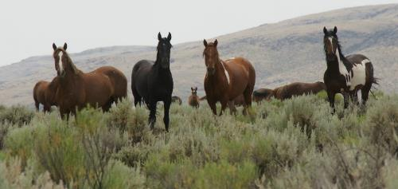
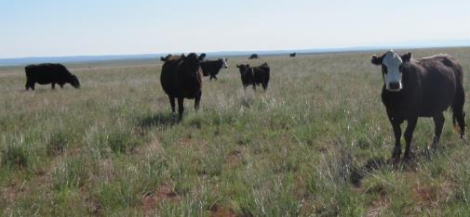
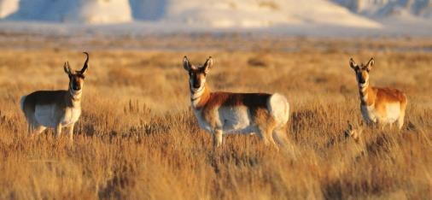
Herbivore Size
Intake of range herbivores varies from 2 to 4% of body weight consumed per day.
  Intake factor predicts amount of dry matter eaten per day as % of live body weight.
Smaller herbivores eat a greater proportion of body weight per day.
  Smaller animals have greater nutrient requirements per pound of body weight than larger.
  Smaller herbivore select higher quality more digestible diet (i.e., leaves over stems).
Justin Trujillo
Connor White
Tom Koener (USFWS)

Slide 6
Herbivore Size
Smaller herbivores eat a greater proportion of body weight per day.
Ruminant wildlife and livestock intake factors for estimating daily forage demand.
Live weight (lb.) | Intake factor (% of live weight) | Intake (lbs)
1,000-1,500 | 2.5% | 25 to 37.5
500-1,000 | 3% | 15 to 30
100-500 | 3.5% | 3.5 to 17.5
less than 100 | 4% | < 4
Understanding forage intake in range animals. 1995. by Lyons, Machen, and Forbes.

Slide 7
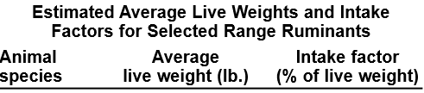
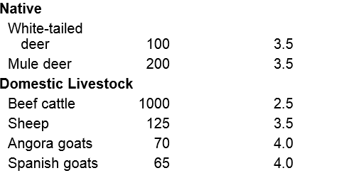
Herbivore Size
Smaller herbivores eat a greater proportion of body weight per day.
Understanding forage intake in range animals. 1995. by Lyons, Machen, and Forbes.

Slide 8
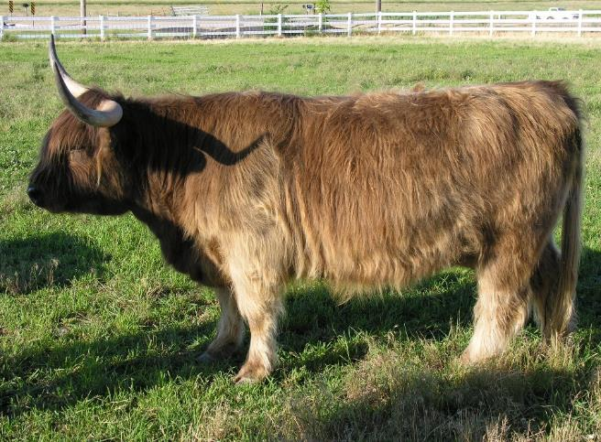
Physiological State
Greatest nutrient demand and intake during lactation
  Can eat 35 to 50% more forage when lactating than when dry
Intake generally declines in late gestation
  Fetus may take reduce space for rumen
  High estrogen levels may reduce appetite
K. Launchbaugh

Slide 9
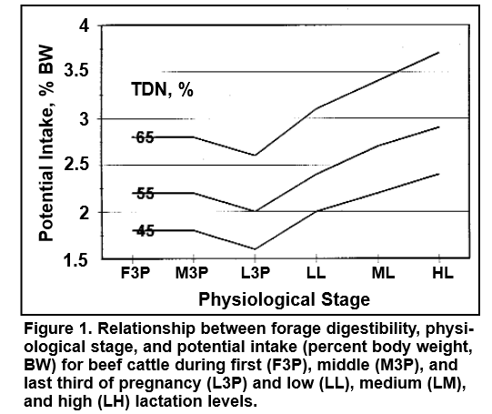






Physiological State
From -Understanding forage intake in range animals. 1995. by Lyons, Machen, and Forbes.

Slide 10
Forage Quality
How does intake vary throughout the year?
Winter
Spring
Summer
Fall

Slide 11
Forage Quality
Yes,
  Higher nutrient value & digestibility means animals need to eat less to meet demand.
But,
  Higher nutrient value & digestibility means forage is quickly digested and animals are able to eat more.
Therefore,
  Intake increases as forage quality increases

Slide 12
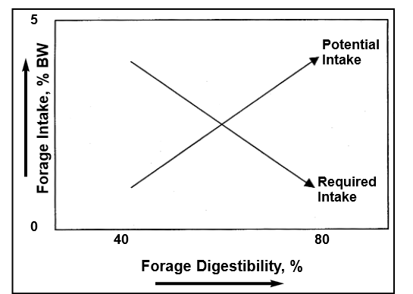
Forage Quality
From -Understanding forage intake in range animals. 1995. by Lyons, Machen, and Forbes.

Slide 13

Water Content
High water content can reduce intake
  Only true in very moist/mesic conditions
  Water is generally easily absorbed not restricting intake.
Low intake early in the spring
  Due to limited forage available
  Not because of high moisture in forage

Slide 14
Forage Characteristics & Foraging Behavior
Moist leafy plants more palatable and more easily eaten than dry stemmy forage.
Forages that provide larger bite size and faster bite rate afford great intake
Anti-quality compounds in forage can make animal nauseous and can reduce intake or halt foraging.

Slide 15
Supplemental Feeding
Supplement Protein:
  Low protein settings → Supplementing Protein (or nitrogen) can benefit rumen microbes and generally increase intake.
  Higher protein settings → Supplementing Protein (or nitrogen) will depress intake of other forages.
Supplement Energy:
  Low energy settings → Supplementing energy will help meet animals demand but animals will continue foraging.
  Higher energy settings → Supplementing energy will “substitute” for forage and reduce intake.

Slide 16
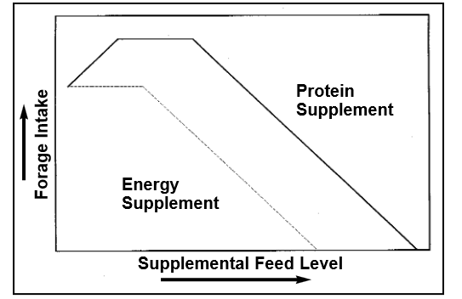
Supplemental Feeding
From -Understanding forage intake in range animals. 1995. by Lyons, Machen, and Forbes.

Slide 17
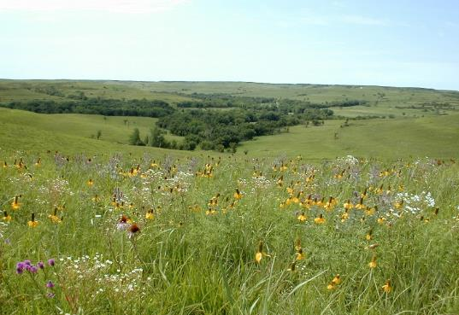
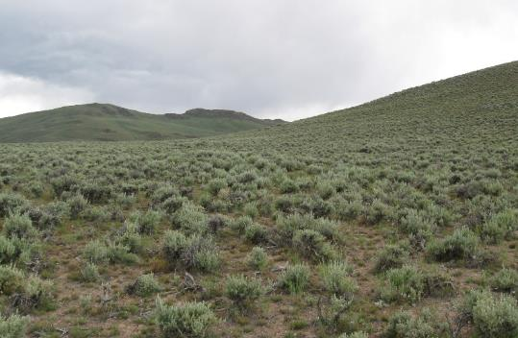
Forage Standing Crop
Forage Quantity can affect intake
  Standing crop > 2,500 lbs/acre no effect on intake
  2,500 to 1,000 lbs/ac = declining intake
  <1,000 lbs/ac = rapidly declining intake
Forage Allowance
  pounds forage dry matter/100 pounds animal live weight
  More related to intake than standing crop
M. Haddock
K. Launchbaugh

Slide 18
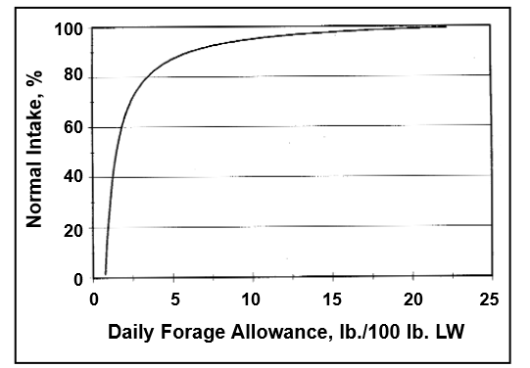
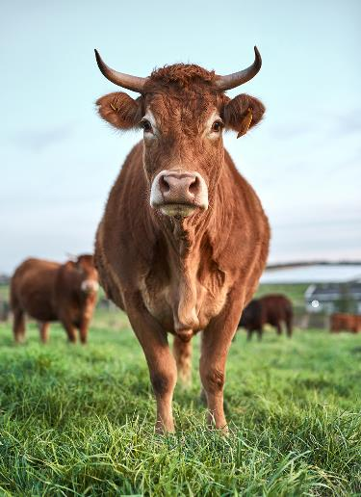
Forage Standing Crop
Forage Allowance
= pounds forage dry matter per 100 pounds animal live weight
From -Understanding forage intake in range animals. 1995. by Lyons, Machen, and Forbes.

Slide 19
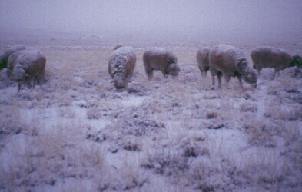
Environmental factors affect intake
Cold temperatures
  Increase demand and intake
  Can reduce intake if snow, ice, or storms limit
  ability of animal to forage
Hot temperatures
  Decrease intake
  Night cooling & foraging at night can improve intake in hot season
K. Launchbaugh

Slide 20
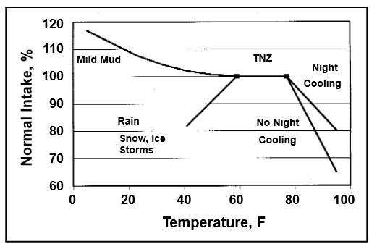
What environmental factors affect intake?
From -Understanding forage intake in range animals. 1995. by Lyons, Machen, and Forbes.

Slide 21
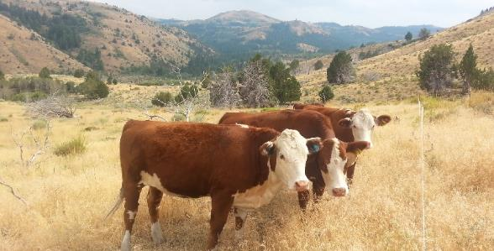
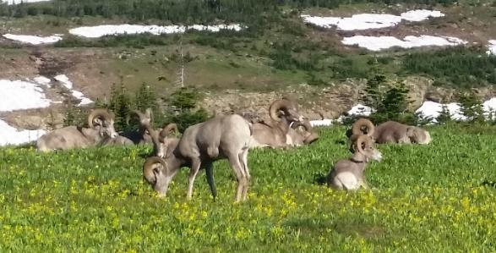
Conclusions – Intake affect
Many characteristics or factors affect intake:
  Animal
  Forage
  Environment
Understanding forage intake is important, because it affects animal nutrient status.
Estimates of intake on a yearly basis (i.e., 2.5% of BW/day throughout year) are gross averages that gloss over true variation.
B. Jacobson
K. Launcbaugh

Slide 22
Herbivore Intake
K. Launchbaugh
BLM
Tom Koerner USFWS
Integrated Rangeland Management

